Slide 1
Subject Recruitment
Nikunj, Bin, Ashley, Zhetuo

Slide 2
Subject Screening
•3 forms: Consent, Demographics, Screening
•Tell subject what we do and what they can expect to be doing. Make sure to tell them that they get paid only if they pass the screening test.
•They should be given the Screening form which they should read and sign. It needs the experimenter’s signature as well.
•Visual Acuity Test:
•Ask the subject to stand just behind the blue line and ask them to close one eye at a time.
•Try the 20/20 line first; if they miss 2 or more, go up to the 20/25 line
•If they miss 2 or more on the 20/25 line, they have failed the screening
•If they get all correct, keep moving down the chart until they miss 2
•Record their result on the demographic form

Slide 3
•Then hand the demographics and consent forms to the subject and give them time to go through it. Make sure the form is signed and dated.
•Assign them a subject # from the list, write it on the demographics form and on the numbers log. If MR’s study then use subject # starting with ‘A’ and for MP’s study starting with ‘Z’
•Using the chin rest, check if we can track their eye
•Explain in general about the system
•Explain the calibration procedures
•Explain the gamepad buttons
•“Follow my finger" test

Slide 4
•If tracking went well, make bite bar:
•There’s a box with two jars of putties (purple and white) in it in the cabinet near the Listerine stash. Using the gloves in the same cabinet, take one scoop of each putty and mix them up really fast.
•The metal bars are stored in a box above the sink. The flat bar is the top. Break the mixed putty into two pieces and roll them. Place one on each side of the bar.
•The front teeth need to go pretty far forward. Mark that spot with a (gloved) finger before the subject bites it - this gives the subject an idea of where to bite.
•Once bitten, leave it for a minute or two. Remove it, place it in a bowl with 2 pumps of Listerine, topped off with water, for a while. Along with an eye patch, store it in a Ziploc bag labeled with their subject # that is on their demographic form.

Slide 5
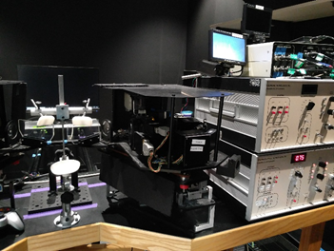
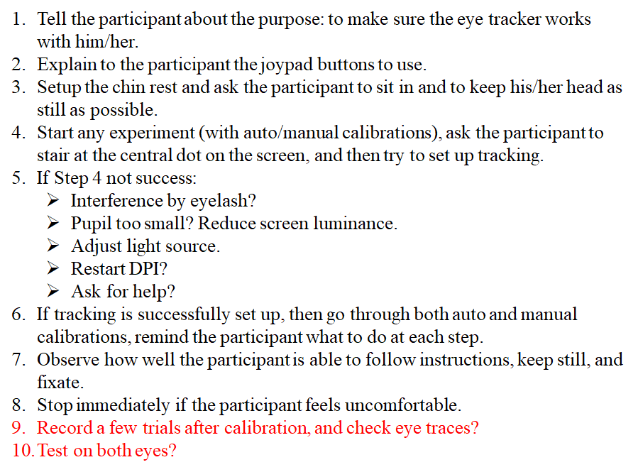

Slide 6
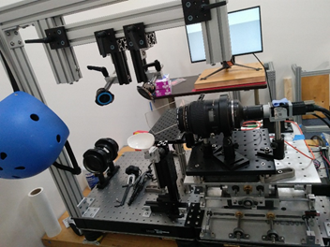

Slide 7
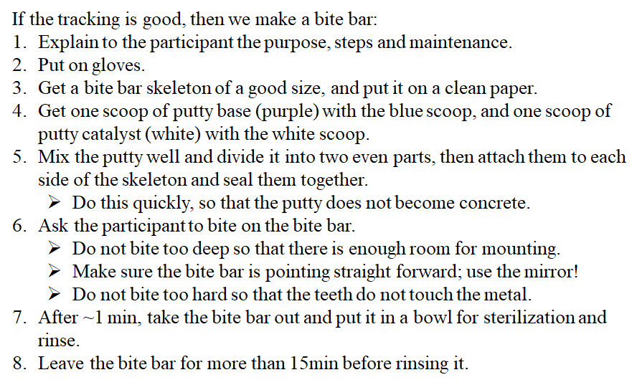

Slide 8
Zeiss – CIRRUS HD OCT 4000
Remove Cap, Power, Login …
Blue vs White Chin Rest
Don't allow subject to touch machine until ready for scanning

Slide 9
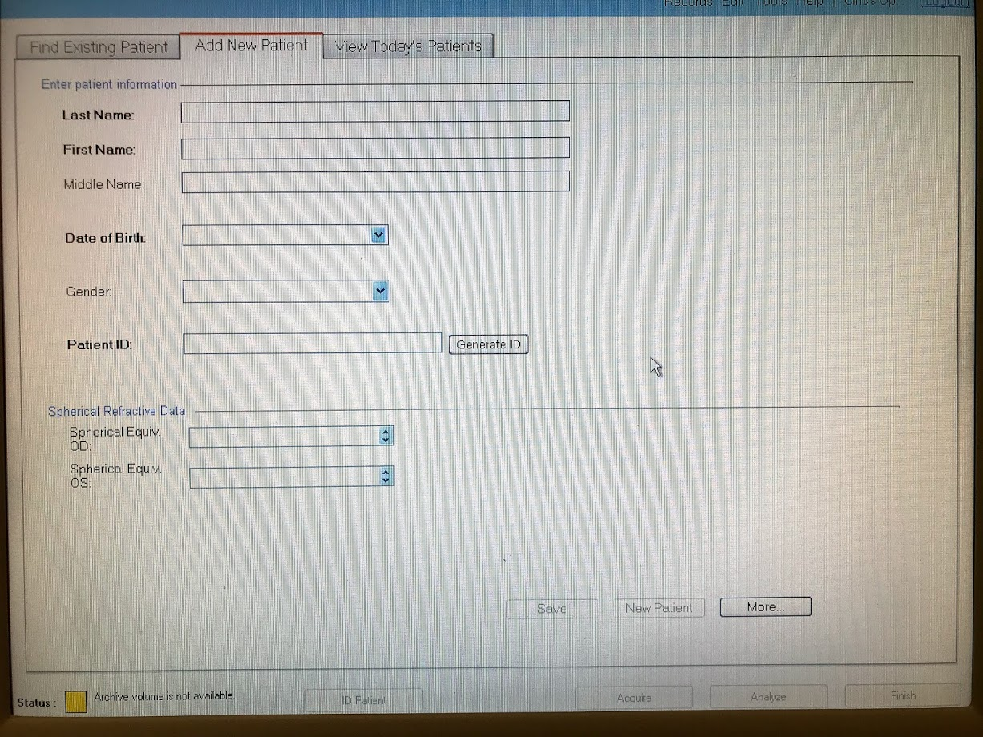
Zeiss – CIRRUS HD OCT 4000

Slide 10
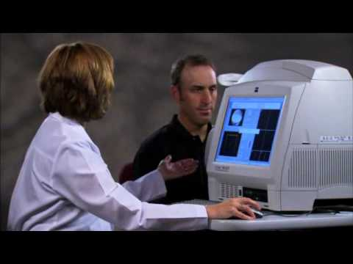
Zeiss – CIRRUS HD OCT 4000
https://www.youtube.com/watch?v=_xoJ_t_H09Y

Slide 11
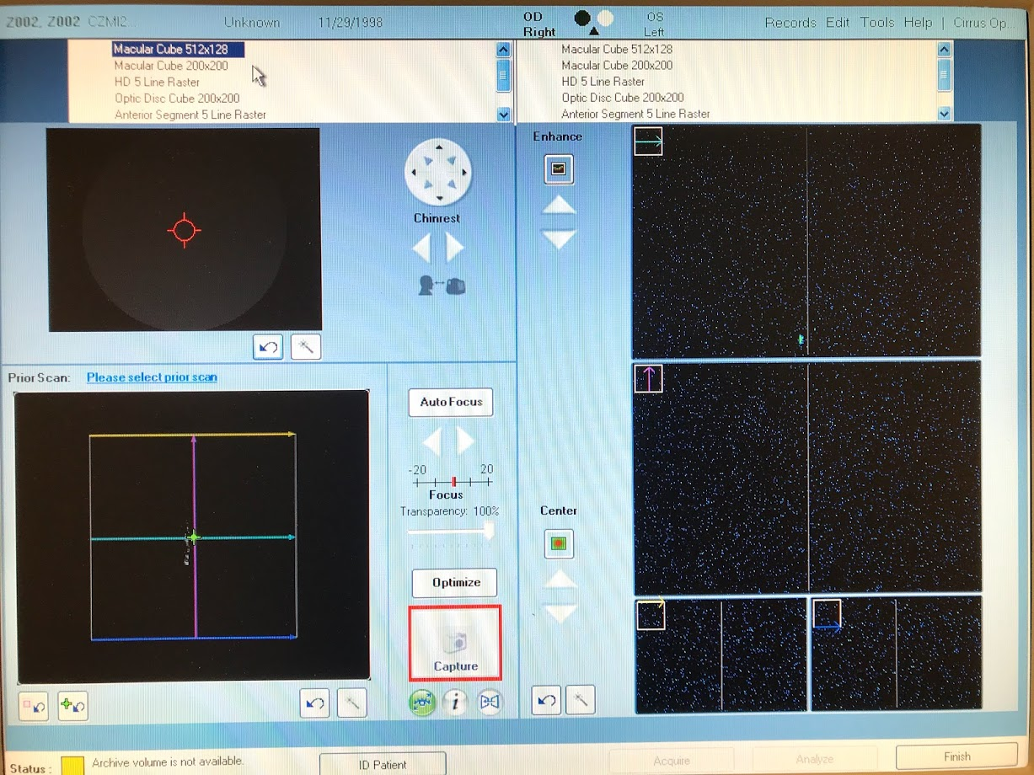

Slide 12
Analyze Macular Cube
Highlight "Macular Cube"
Highlight "Macular Thickness Analysis"
Take note of Fovea scans location (A and B Scan)
Advance Export Option
(6mm Cube Base)
Notes:
(6mm Cube Base)

Slide 13
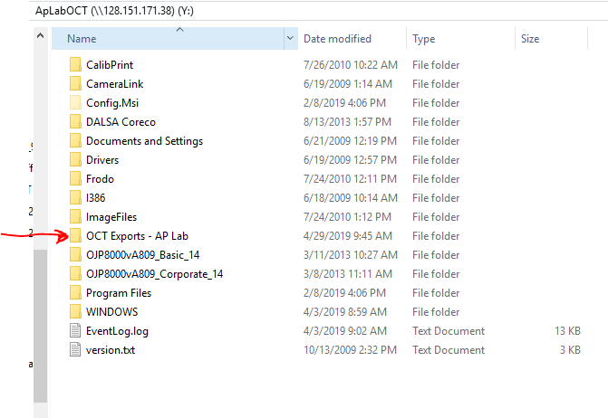
Store Information
Save .dat files onto C Drive of OCT (folder with the day’s date)
Add information on to SubjectData.xlsx (on Opus)

Slide 14
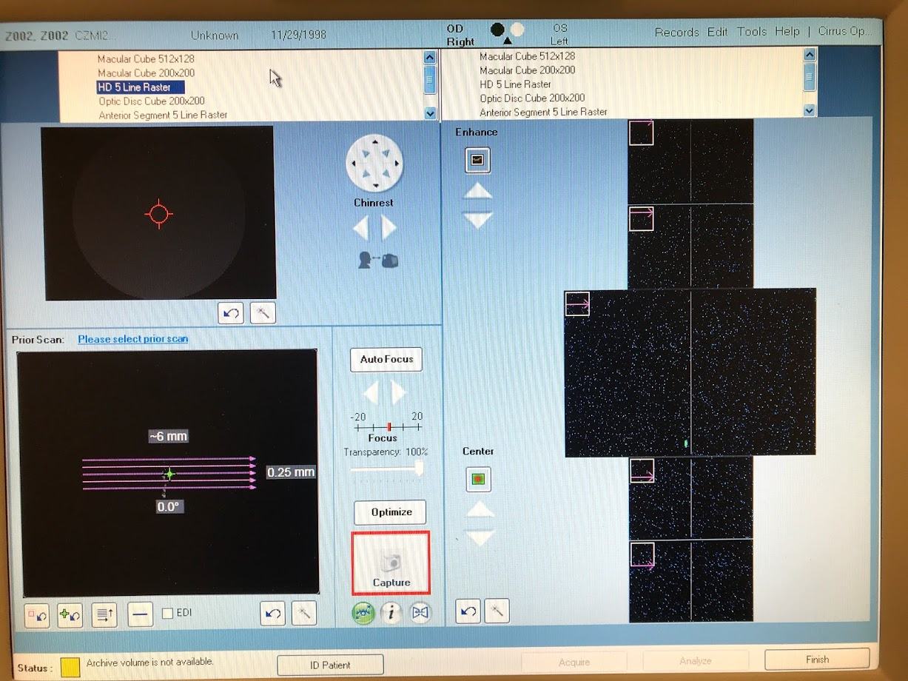
Do .5mm AND 0mm Spacing Line Scan

Slide 15
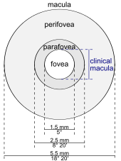
Analyze Line Scan
More detailed image
Less area total covered (longer area covered – 6mm line)
Scans only in one direction
Extract using "Image Export"
No current software for analyzing
Chan, A., Duker, J. S., Ko, T. H., Fujimoto, J. G., & Schuman, J. S. (2006). Normal macular thickness measurements in healthy eyes using Stratus optical coherence tomography. Archives of ophthalmology (Chicago, Ill. : 1960), 124(2), 193–198. doi:10.1001/archopht.124.2.193

Slide 16
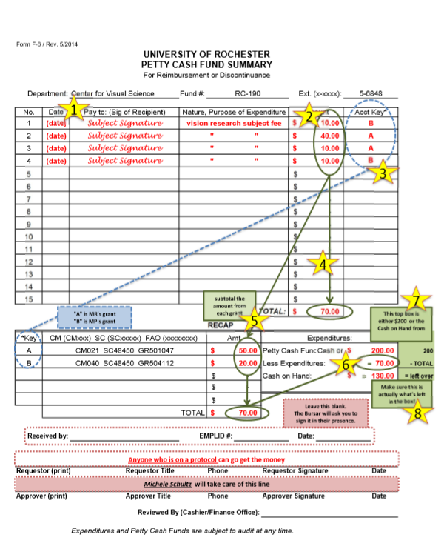
Paying a Subject
How much does your study pay?
How long did they work?
We can pay by the ½ hour.
Where to sign?
Receipt
Paper
Check Balance
If below $40, contact bursar point person
of the week.
NEW BURSAR SCHEDULE
* Please check the calendar

Slide 17
Storing Information: IOL Master and Autorefractor
Storing on REDCap
This will be a part of the screening process for many subjects (Myopia)
Safe, easily accessible way to store and print reports.

