Slide 1
Giorgio’s saccade project
Zhetuo, 08/14/19

Slide 2
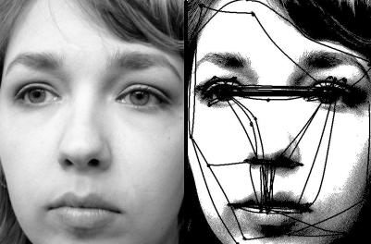
General introduction to saccades
Happens about 3 times per second
Saccades relocate gaze, present new salient information to fovea, can be considered as an active sampling procedure of vision system.

Slide 3
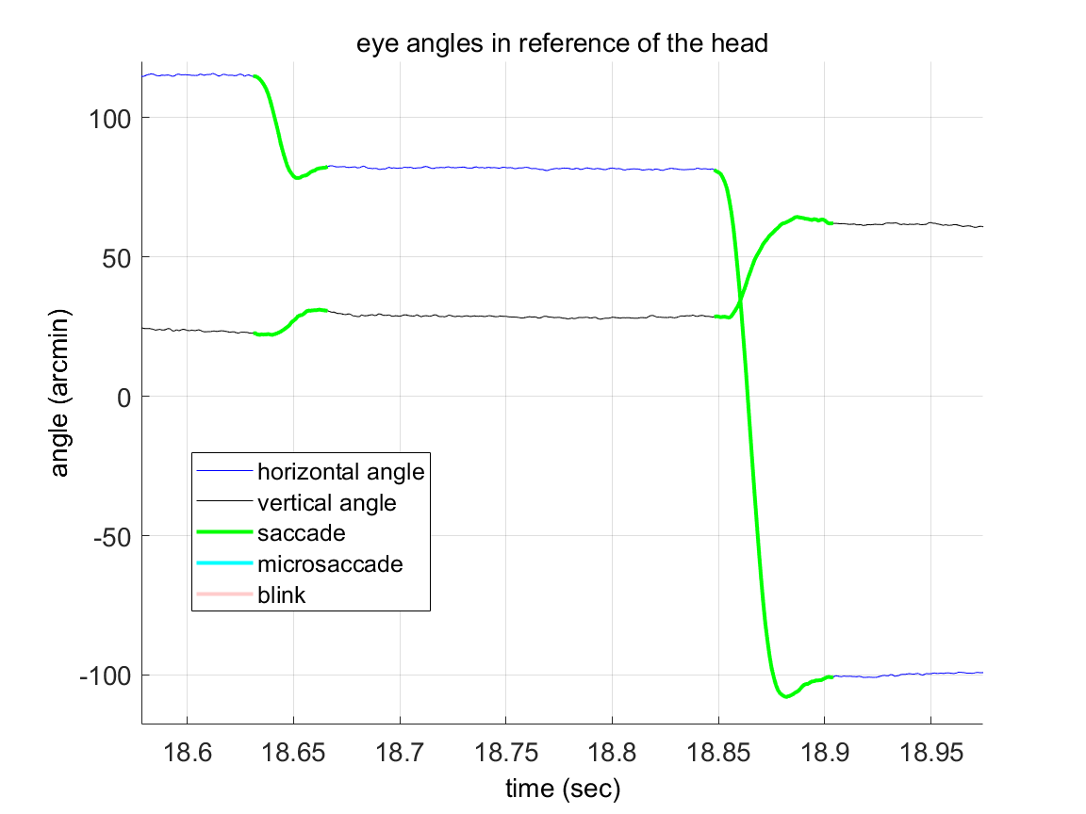
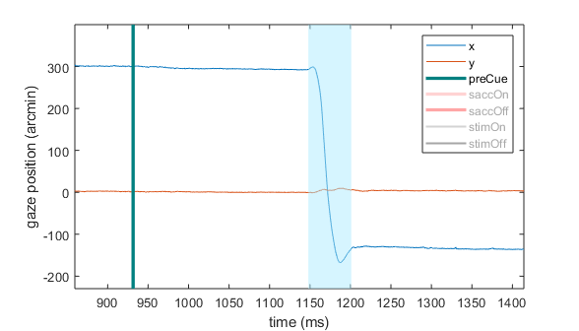
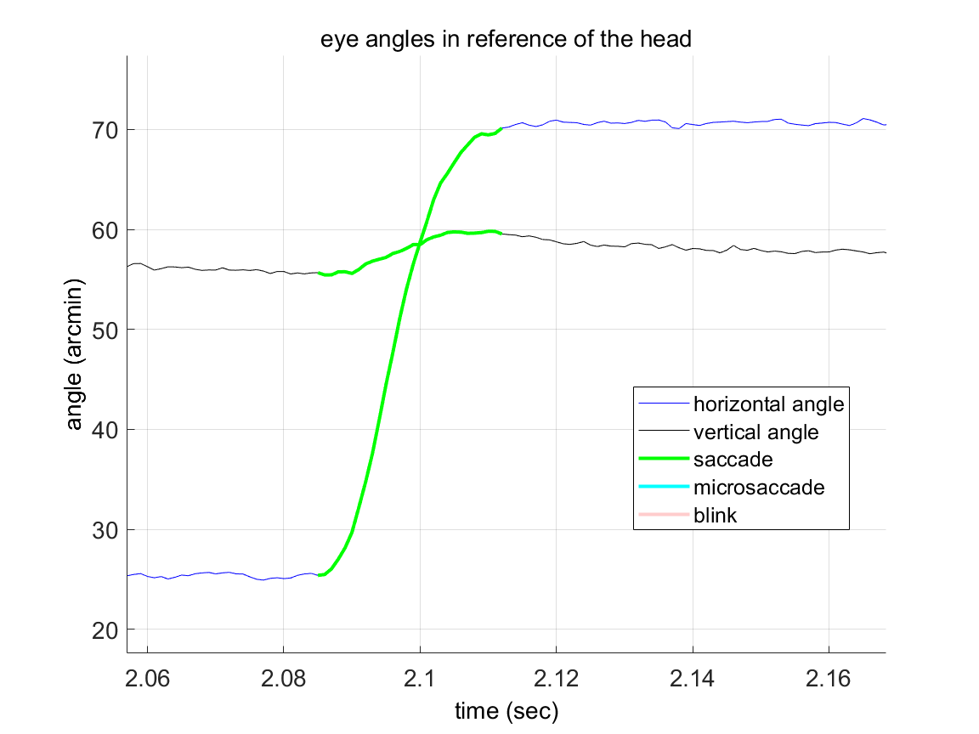
Saccade examples
Peripheral
cue
Saccade
onset
Saccade
offset
Notes:
Here we shows an example of eye trajectory of saccade recorded by the DPI eye tracker. Overshoot and undershoot.
Involuntary saccades: In laboratory environment, introduce saccade, takes 200-300 msec

Slide 4
Studies on saccades
Peripheral
cue
Saccade
onset
Saccade
offset
Transsaccadic integration: change stimulus at saccade onset
Saccade preparation / presaccadic attention: short peripheral presentation
Saccadic suppression: 1-frame flash of stimulus around saccades
Intrasaccadic perception: drifting stimulus that is invisible in fixation
Our study: 1. Exclude effect from presaccadic attention
2. natural temporal transient when stimulus is
presented in fovea by a saccade
Notes:
While saccade can be considered a simple shift of gaze, it is a really complicated perception procedure. There are a lot of studies on different aspects of saccadic influence on visual perception.
4. Here is a brief summary on several popular studies in terms of their stimulus presentation timings.
…
Our lab pay a lot of attention to the temporal transient on the retina, which is the characteristics of retinal input in time. For example, in the saccadic suppression experiments, they flash a luminance impulse on the retina. You can prove the vision is suppressed, but it hard to argue that the result you get is what we really perceive in a saccade, because in a natural saccade, the target sweep through the retina from periphery to fovea. The retinal input flow is just so difference with the impluse. So in our study, we want to include this whole retinal transient and the post-saccadic fixation, and investigate how this saccade plus drift, this two-step procedure, will influence our visual perception. In the meanwhile, we don’t want to include effect from pre-saccadic attention, which will make things too complicated.

Slide 5
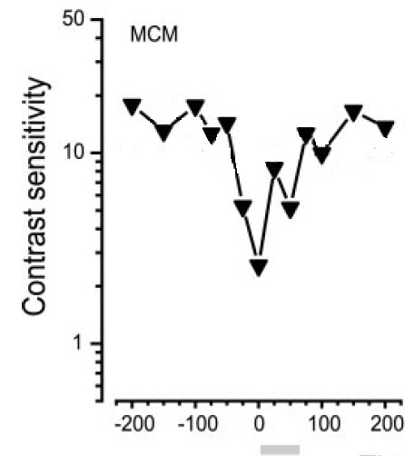
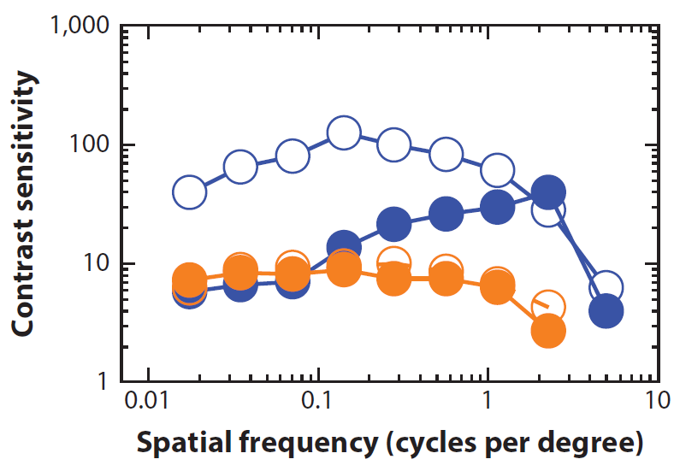
Saccade suppression
Temporal profile: maximum suppression at saccade onset, fast recovery.
Selective to low spatial frequencies and luminance variance (M-type RGC)
Time from saccade onset
(Diamond et al., 2000)
Lumi, Fix
Lumi, Sacc
R/G, Fix
R/G, Sacc
(Burr et al., 1994)
Notes:
The suppression is not super strong

Slide 6
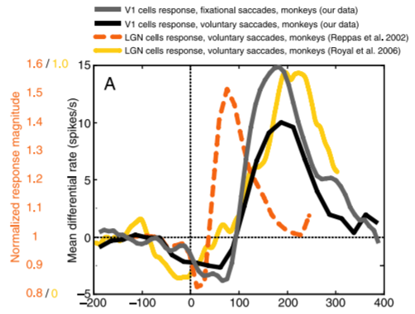
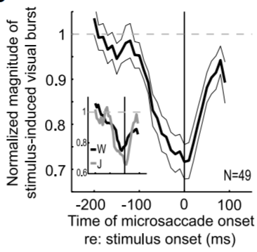
Saccade suppression
Temporal profile: maximum suppression at saccade onset, fast recovery.
Selective to low spatial frequencies (up to 1 cpd) and luminance variance (M-type RGC)
Neurophysiology data:
weak suppression + strong enhancement: LGN, V1, V4 (enhancement is additive)
Suppression + recovery: SC, LIP
Time from saccade onset (ms)
(Kagan et al., 2008)
SC response in microsaccade
(Hafed & Krauzlis, 2010)

Slide 7
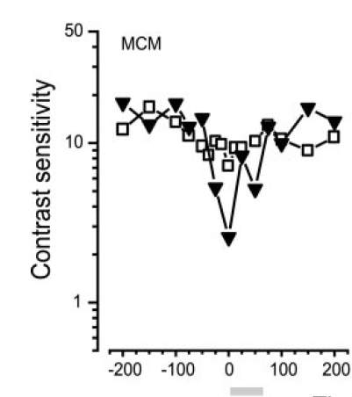
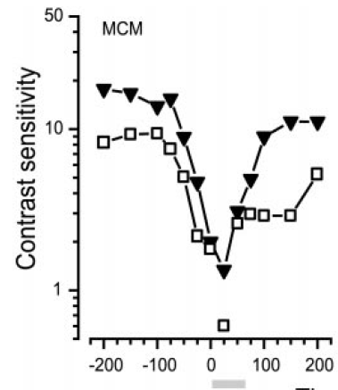
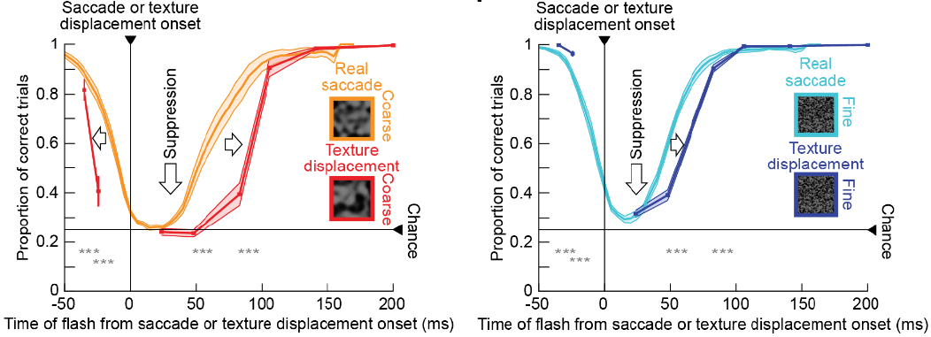
Uniform background
patterned background
Saccade suppression
Real
Real
Simulated
Simulated
Temporal profile: maximum suppression at saccade onset, fast recovery.
Selective to low spatial frequencies (up to 1 cpd) and luminance variance (M-type RGC)
Neurophysiology data:
weak suppression + strong enhancement: LGN, V1, V4 (enhancement is additive)
Suppression + recovery: SC, LIP
Extra-retinal (motor command) or retinal effect ?
Strongly depends on background:
Uniform background: extra-retinal effect only.
Patterned background: suppression at retinal level (heavier suppression in coarse), motor command actually helps the fast recovery.
The selective to low frequency gratings can be replicated by simulated saccades.
Time from saccade onset
Time from saccade onset
(Diamond et al., 2000)
(Idress et al., 2019)

Slide 8
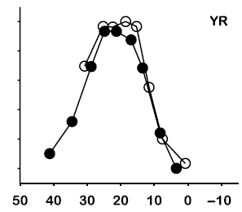
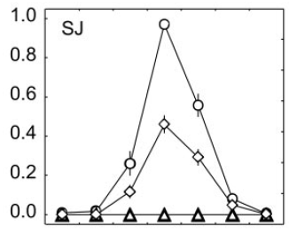
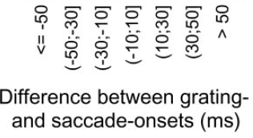
Does the temporal transient matter?
It matters during ocular drift (grating, Snellen test)
Does it matter during saccade given saccadic suppression?
Intra-saccadic motion perception.
Fast drifting (300 or 360 degree/sec) low frequency (0.17 cpd) gratings can become visible during saccade
Short presentation (15 ms) of static low frequency gratings can be perceived as in reverse motion
Peak retinal temporal frequency (Hz)
(Castet & Masson, 2000)
Difference between grating- and saccade-onsets (ms)
(Castet et al., 2002)
Notes:
The temporal transient on the retina creates part of the saccadic suppression itself

Slide 9
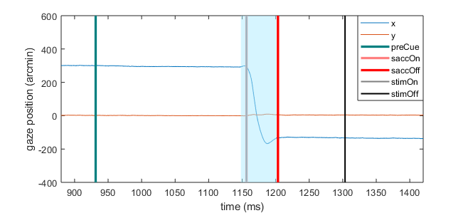
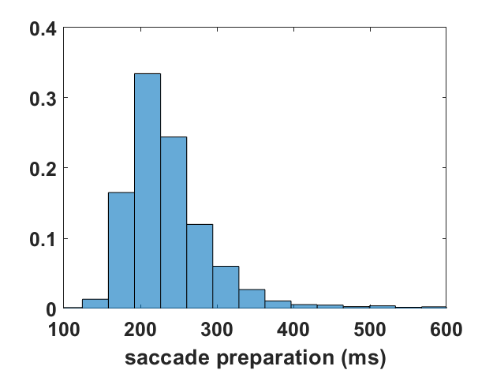
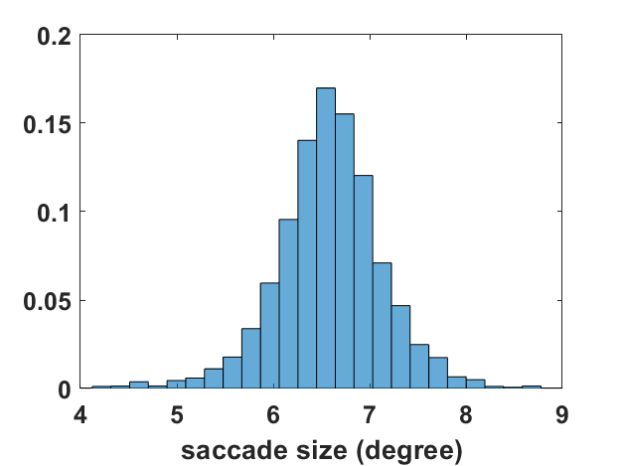
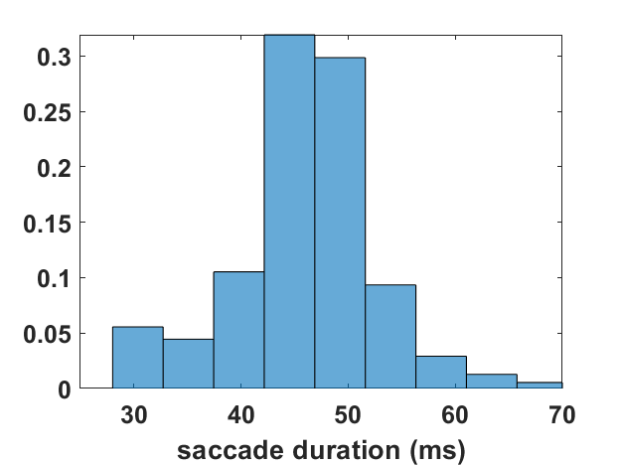
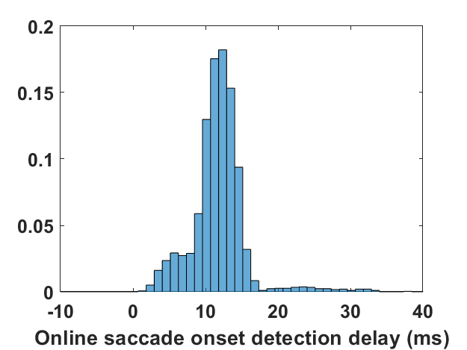
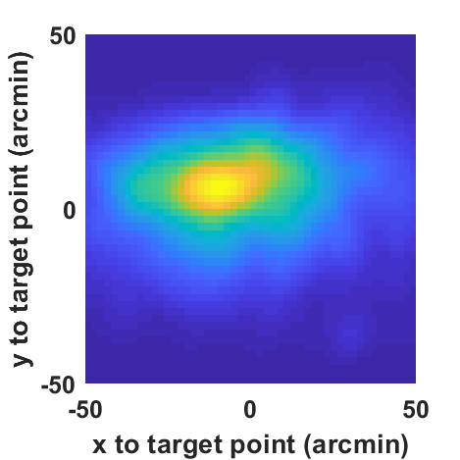
Experiment Procedure:
saccade onset condition
1-1.5 s
100 ms
Peripheral cue
(${6.75}^{°}$away)
saccade onset
Initial fixation
stimulus onset
saccade offset
stimulus offset
Test contrast sensitivity for gratings at 1, 4, 8 cpd
Discrimination task between tilted ${45}^{°}$ left or right
Gratings has a Gaussian envelop (std =$1^{°}$)
Notes:
Back to our study, we want to investigate when the stimulus is introduced to fovea by a natural saccadic transient,
1. Because we using dpi to track our gaze, overshoot
2. Online vs offline saccade detection

Slide 10
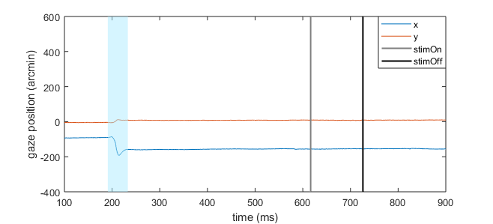
Experiment Procedure: fixation condition
1-1.5 s
100 ms
Initial fixation
stimulus onset
t
stimulus offset
Pure drift
Notes:
Because we want to study how saccadic transient changes visual perception, we need a reference.

Slide 11
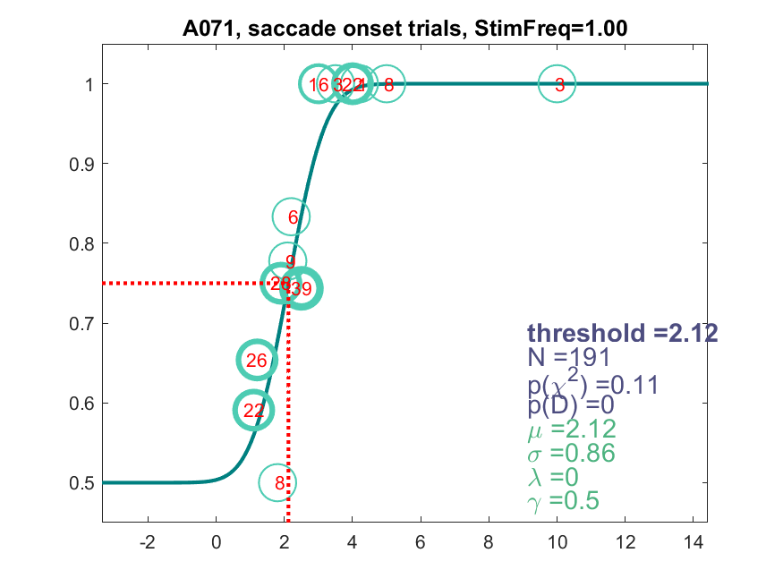
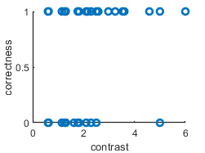
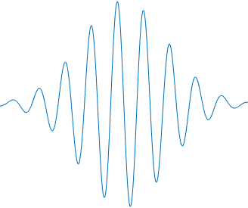
Contrast sensitivity threshold estimation
Michelson Contrast = $\frac{L_{max}−L_{min}}{L_{max}+L_{min}}=\frac{g_{max}−g_{min}}{g_{max}+g_{min}}$
$$contrast threshold$$
Contrast Sentivity = 1/ Michelson Contrast
$$=\frac{g_{max}+g_{min}}{g_{max}−g_{min}}=\frac{127}{contrast threshold}$$
$$127$$
$=$ is only true when the screen is linearized
Notes:
During the experiment, we adjust the contrast of the grating by a staircase algorithm.

Slide 12
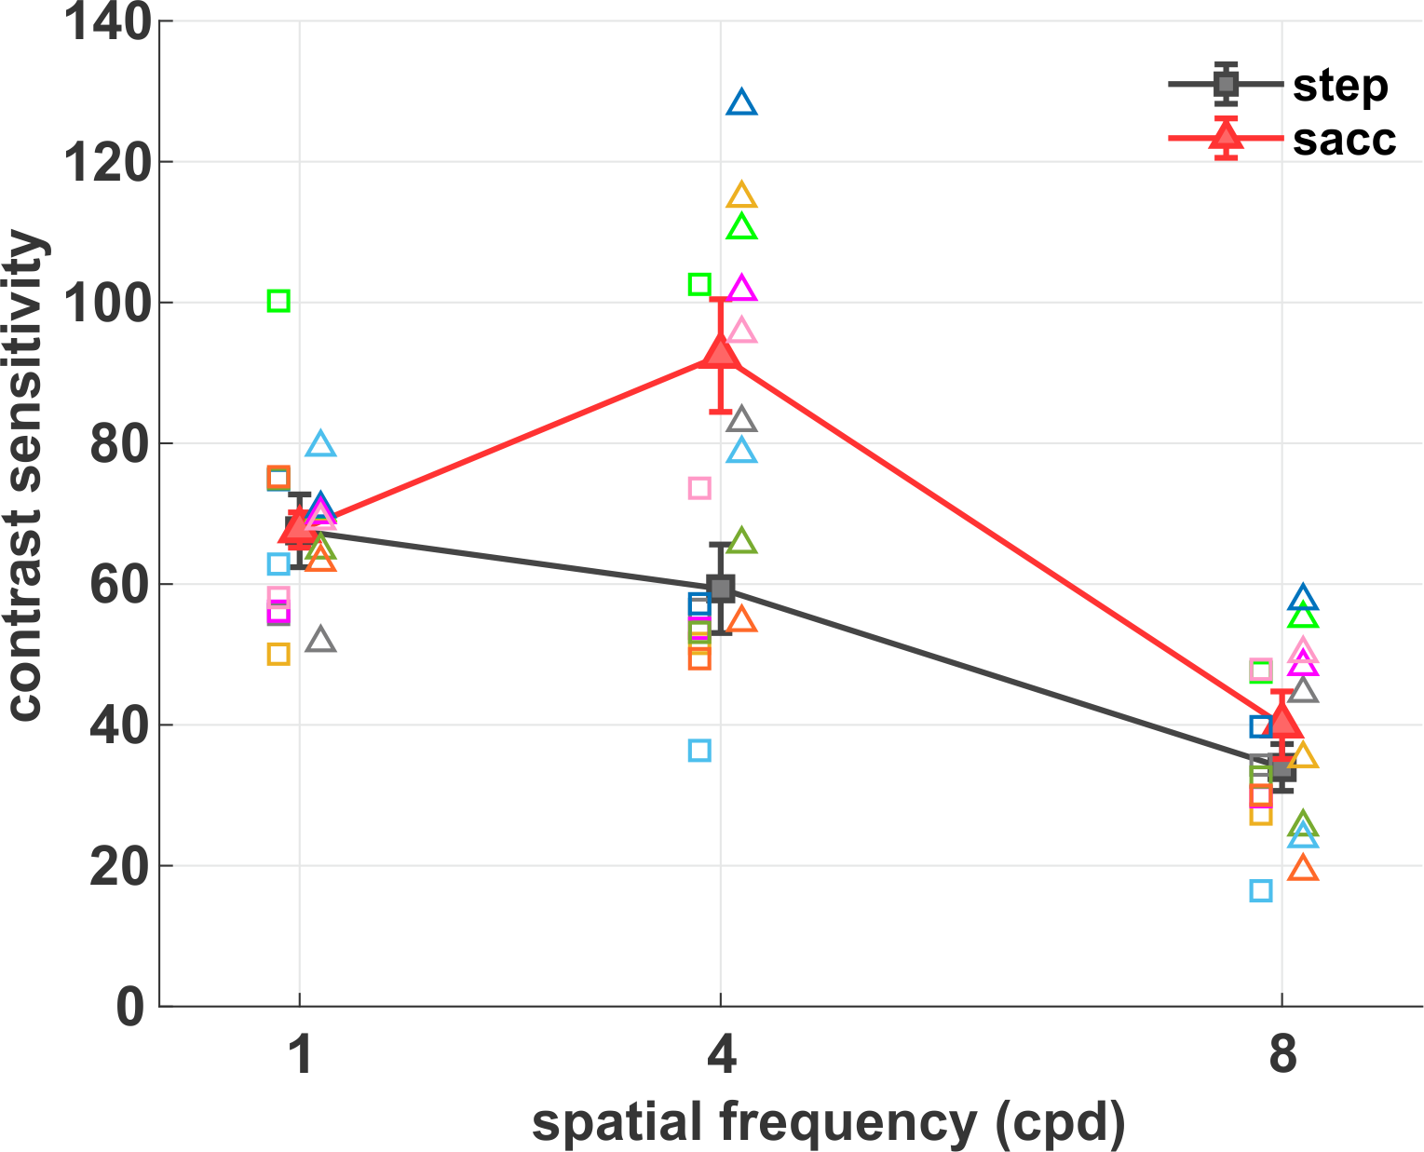
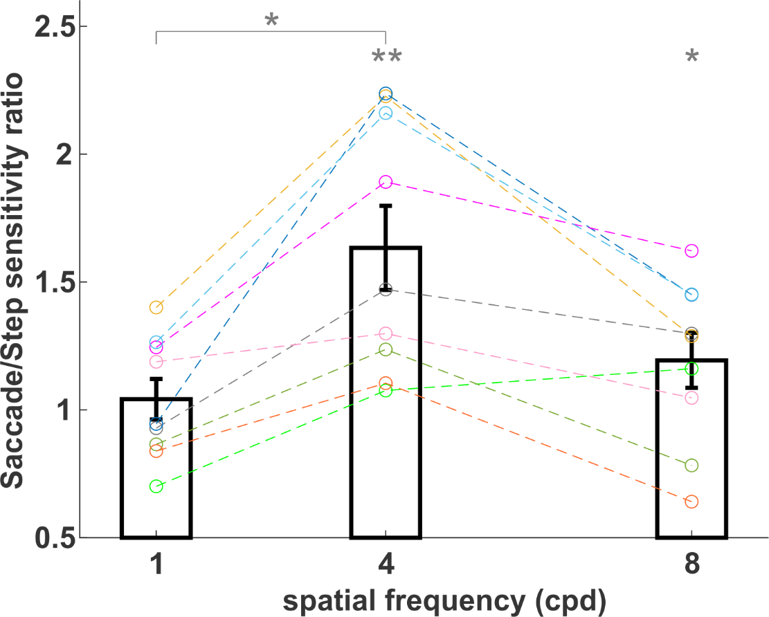
Main results
fixation
saccOn
saccOn/fixation sensitivity ratio
Solid lines represent the average contrast sensitivity across observers. Errorbars are SEM. Symbols are data from individual subjects.
Ratio between contrast sensitivity in the two conditions. Dashed lines show ratios for individual subjects. Errorbars indicate SEM. (*) p < 0.05, (**) p < 0.01.
Notes:
Data was collected by Giorgio

Slide 13
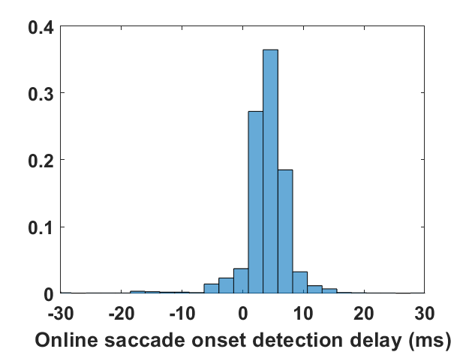
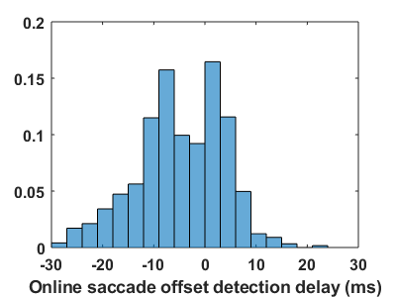
Saccade offset control
1-1.5 s
stimulus onset
100 ms
Initial fixation
Peripheral cue
saccade onset
saccade offset
stimulus offset
DPI, CRT screen, luminance 6.9 $cd/m^{2}$
dDPI, LCD screen, luminance 3.78 $cd/m^{2}$
Notes:
Too many factors mixed together
Introduce the saccade offset condition
3 subjects on dDPI for all the three conditions

Slide 14
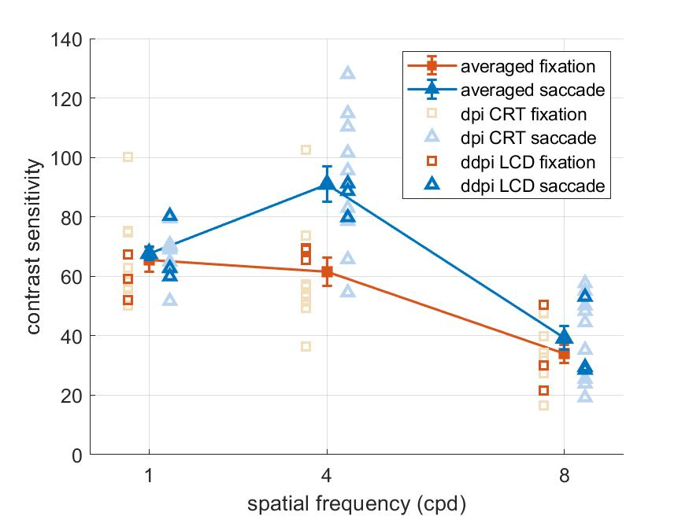
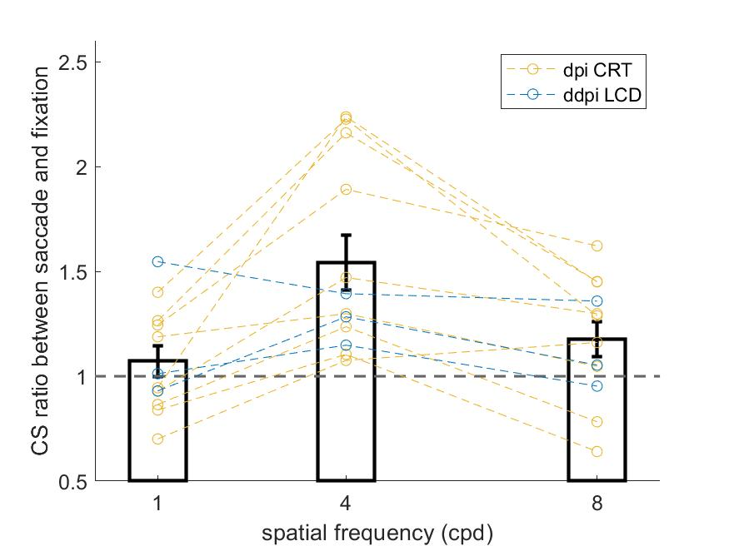
Comparison between control data and Giorgio’s data
Solid lines represent the average contrast sensitivity across observers. Errorbars are SEM. Symbols are data from individual subjects.
Ratio between contrast sensitivity in the two conditions. Dashed lines show ratios for individual subjects. Errorbars indicate SEM

Slide 15
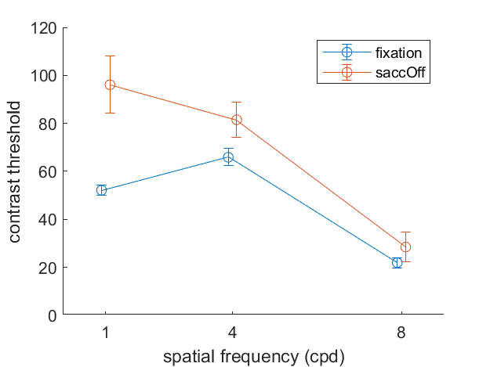
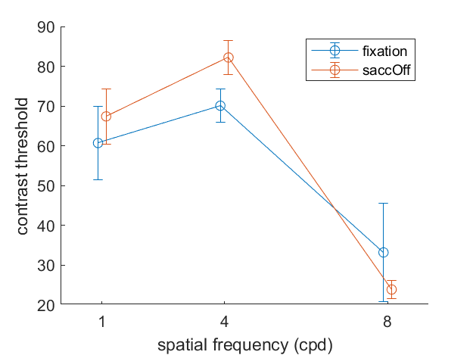
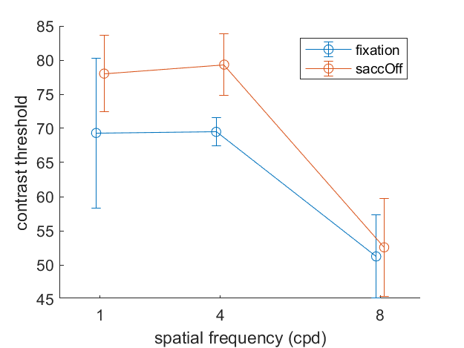
Comparison between fixation and saccade offset
The two conditions have almost identical retinal input
the only difference is the motor command of a saccade
S005
S071
S030
Errorbars indicate std obtained from bootstrap

Slide 16
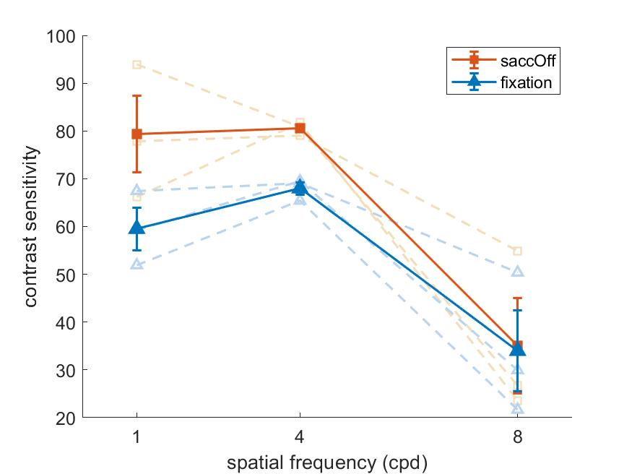
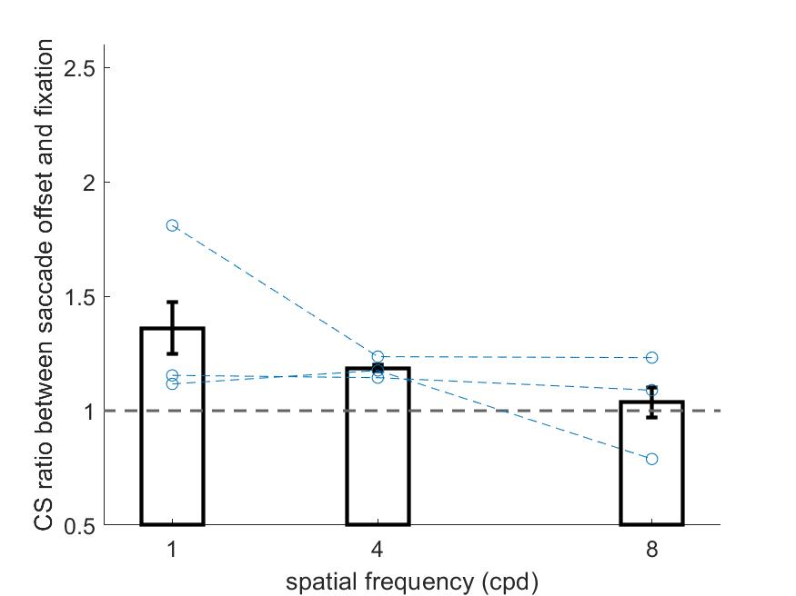
Comparison between fixation and saccade offset
The two conditions have almost identical retinal input
the only difference is the motor command of a saccade
S005
S030
S071

Slide 17
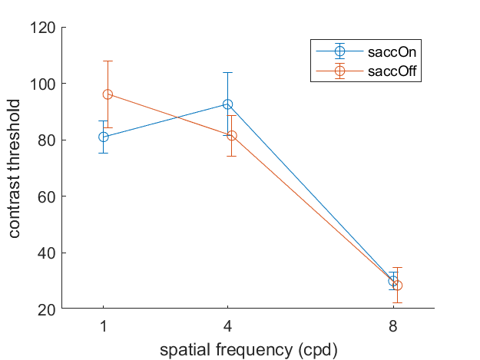
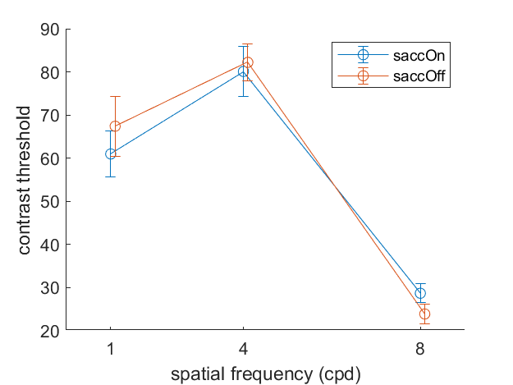
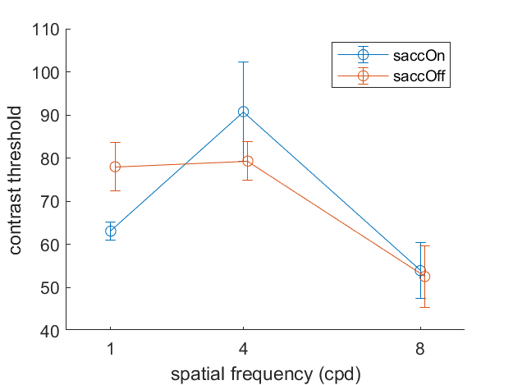
Comparison between saccade offset and saccade onset
Both conditions have the same motor command.
The difference is caused by interaction between retinal transient and extra-retinal modulation (saccade suppression) during saccade
S005
S071
S030
Errorbars indicate std obtained from bootstrap

Slide 18
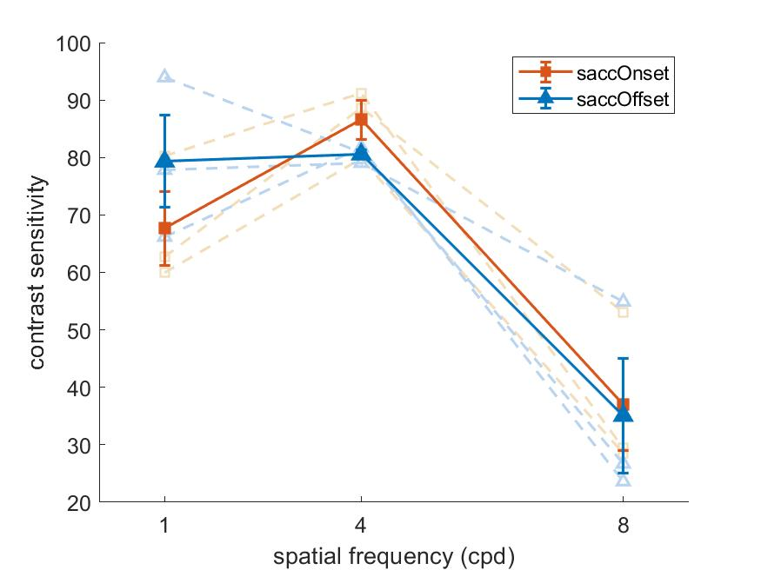
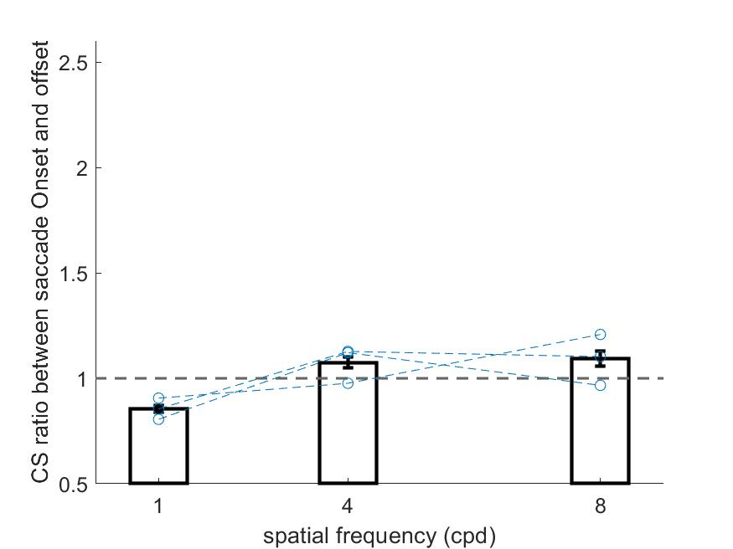
Comparison between saccade offset and saccade onset
Both conditions have the same motor command.
The difference is caused by interaction between retinal transient and extra-retinal modulation (saccade suppression) during saccade
S071
S005
S030
Notes:
Of course, we are going to collect more subjects, but the general trend here suggests that the main effect that Giorgio got

Slide 19
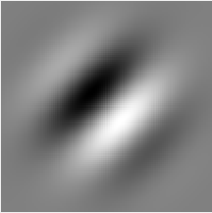
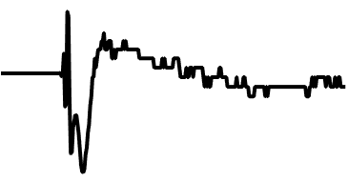
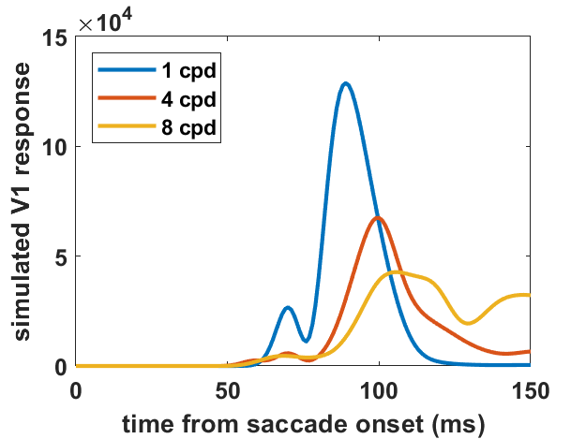
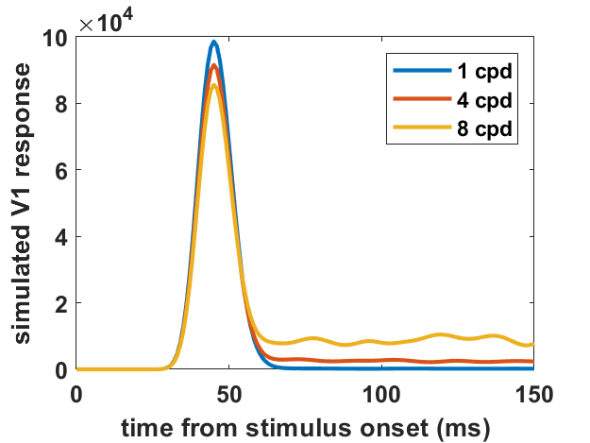
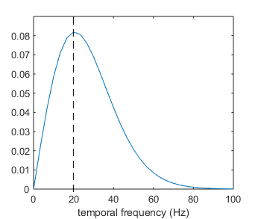
Possible interaction between retinal transient and extra-retinal modulation
+
Temporal frequency tuning of M-type RGC
Saccade onset condition
Saccade offset condition

Slide 20
Possible interaction between retinal transient and extra-retinal modulation
Time from saccade onset (ms)
(Kagan et al., 2008)
Peak of V1 response 1 cpd at 89 ms after saccade onset doesn’t contribute to perception due to the saccade suppression, while the peak of neural response of 4, 8 cpd falls in the enhancement phase of extra-retinal modulation.

Slide 21
Summary
Saccade is a complicated perception procedure. The natural way to introduce a new stimulus to fovea: saccade+dirft yields a very different contrast sensitivity function then a flash.
Visual perception produced during and after saccade depends on both retinal temporal transient and extra-retinal modulation. How those two factors interact with each other is an interesting topic.
It is also interesting to study how contrast sensitivity function (tuning function of spatial frequency) changes during and after saccade.

