Slide 1
Model for
Post Saccadic Dynamics
Bin Yang
12/01/2020

Slide 2
Outline
Motivation
Behavioral Study on Post Saccadic Dynamics
Goals of the Model
Network Framework
Encoding
Encoder Construction: Mosaics, RFs
Modeled Activities
Decoding
Approach
Results
Summary; Issues

Slide 3
Outline
Motivation
Behavioral Study on Post Saccadic Dynamics
Goals of the Model
Network Framework
Encoding
Encoder Construction: Mosaics, RFs
Modeled Activities
Decoding
Approach
Results
Summary; Issues

Slide 4
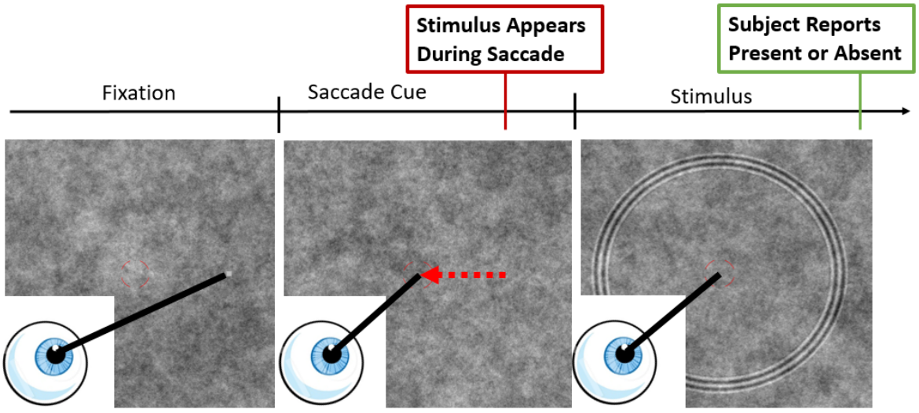
Motivation > Behavioral Study > Paradigm
Eccentricity: $0°$, $4°$, $8°$
Duration: 50, 150, 500 ms

Slide 5
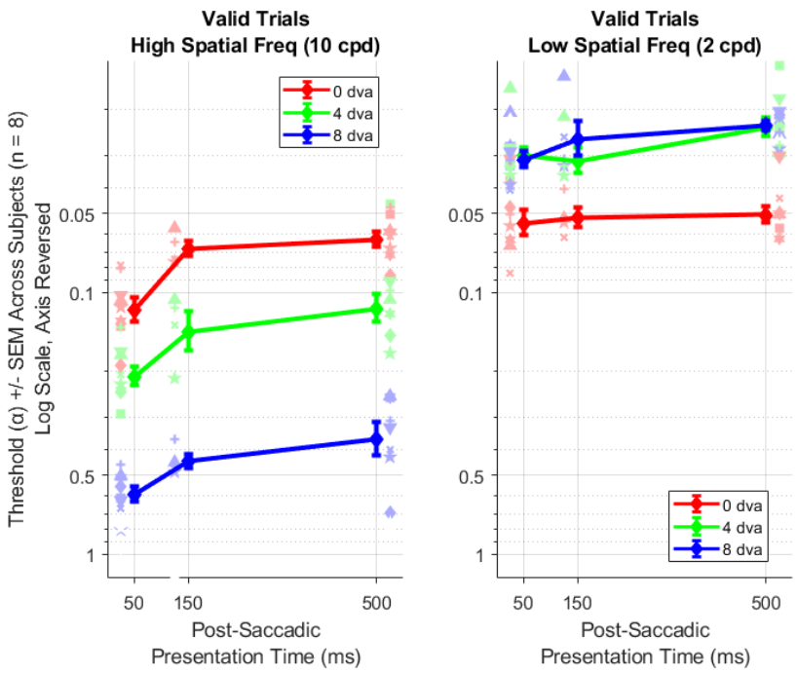
Motivation > Behavioral Study > Results
Contrast sensitivity increases as duration prolongs for 10 cpd
The increment mostly happens within 150 ms
No significant increase in contrast sensitivity for 2 cpd
Contrast sensitivity is higher for 2 cpd
Foveal sensitivity is higher than eccentric for 10 cpd, but the opposite for 2 cpd

Slide 6
Motivation > Goals of the Model
Contrast sensitivity increases as duration prolongs for 10 cpd
The increment mostly happens within 150 ms
No significant increase in contrast sensitivity for 2 cpd
Contrast sensitivity is higher for 2 cpd
Foveal sensitivity is higher than eccentric for 10 cpd, but the opposite for 2 cpd
Goals
Build a neuronal model based on RGCs
Replicate the above behavioral results
Predict that the dynamics of 10 cpd is caused by ocular drifts

Slide 7
Outline
Motivation
Behavioral Study on Post Saccadic Dynamics
Goals of the Model
Network Framework
Encoding
Encoder Construction: Mosaics, RFs
Modeled Activities
Decoding
Approach
Results
Summary; Issues

Slide 8
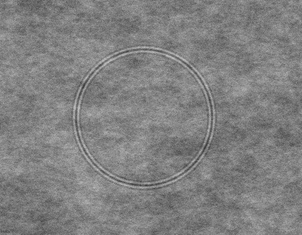
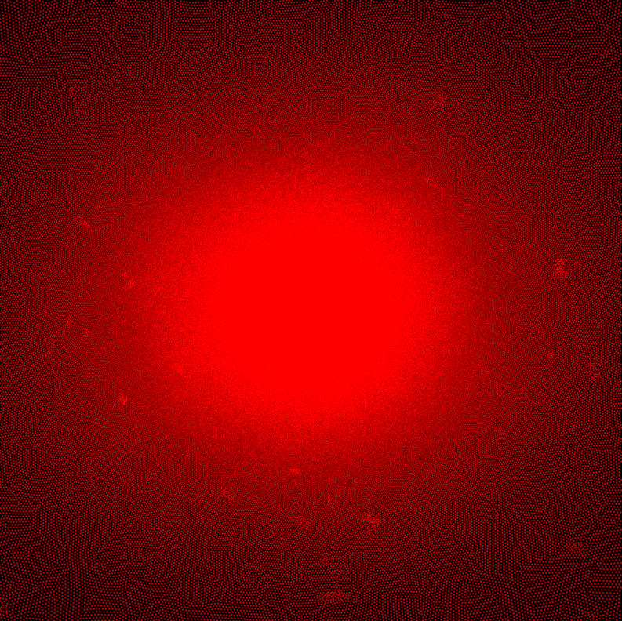
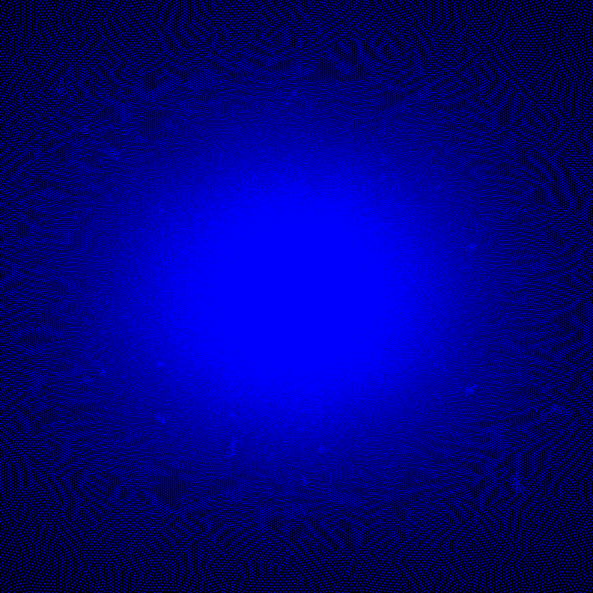
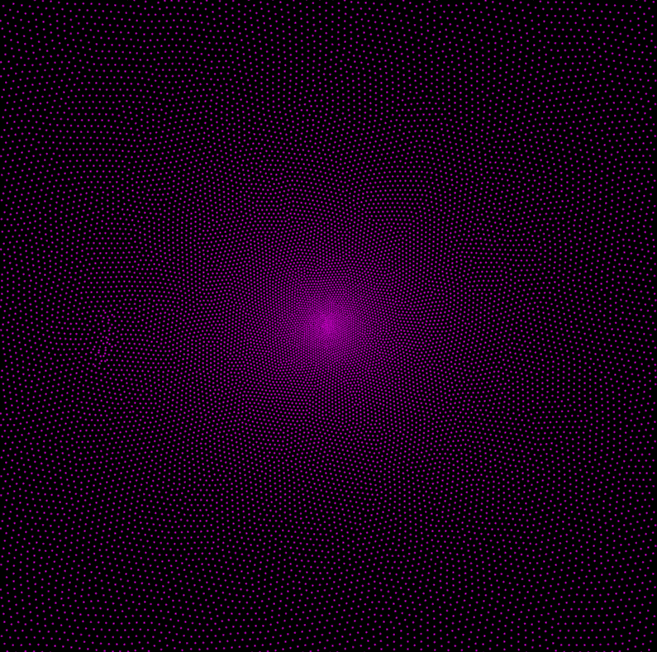
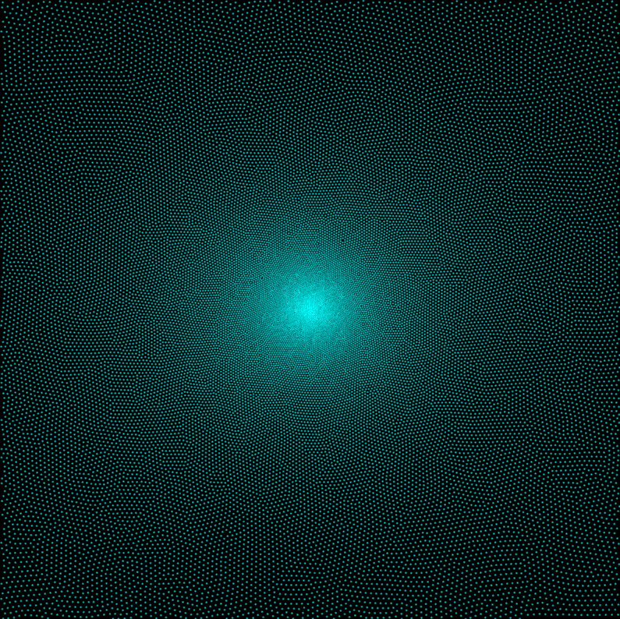
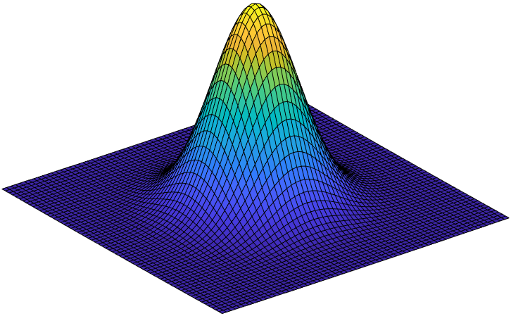
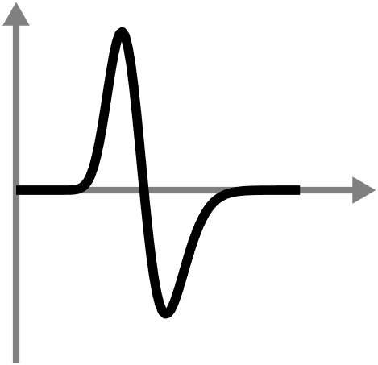
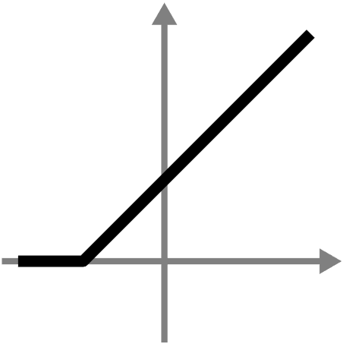
Network Framework
Stimulus
Yes
Neural Activity
Maps
Encoder
Decoder
No
$$+$$
P ON
Eye trace
P OFF
RGC Mosaics^{[1,2,3]}
M ON
M OFF
$$g$$
$$r$$
$$t$$
$$ρ$$
[1] Watson, JoV, 2014
[2] Drasdo et al, VisRes, 2007
[3] Dacey & Peterson, PNAS, 1992
[4] Croner & Kaplan, VisRes, 1995
[5] Benardete & Kaplan, VisNeu, 1999
[6] Benardete & Kaplan, JoP, 1999
Spatial
RF^{[4]}
Temporal
RF^{[5,6]}
Non-
Linearity
$r\left(t\right)={\left[∫∫I\left(x,t−τ\right){RF}_{s}\left(x\right){RF}_{t}\left(τ\right)dxdτ\right]}_{0}$

Slide 9
Outline
Motivation
Behavioral Study on Post Saccadic Dynamics
Goals of the Model
Network Framework
Encoding
Encoder Construction: Mosaics, RFs
Modeled Activities
Decoding
Approach
Results
Summary; Issues

Slide 10
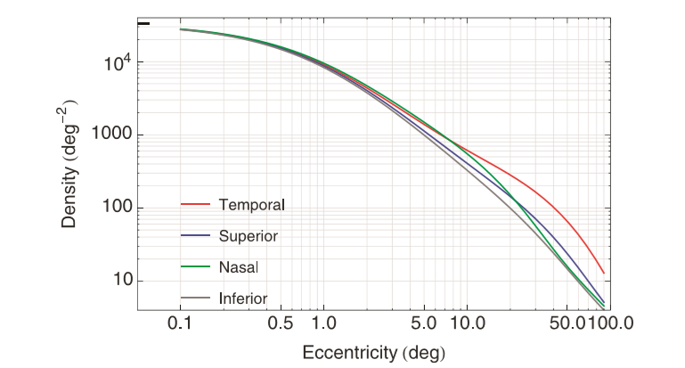
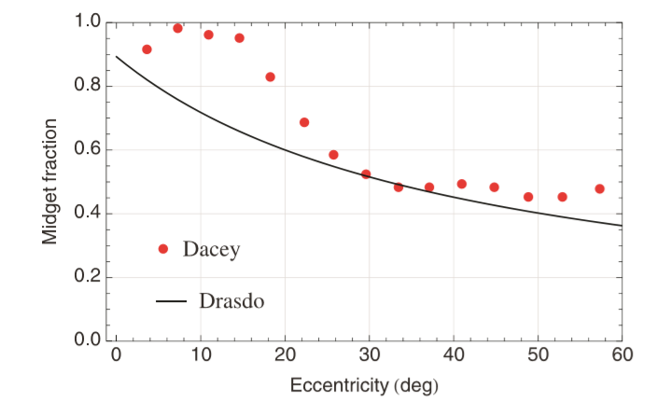
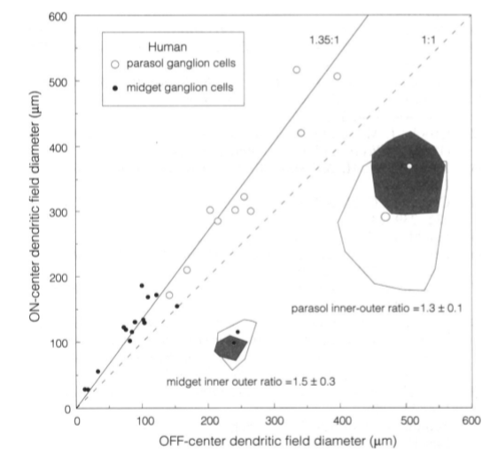
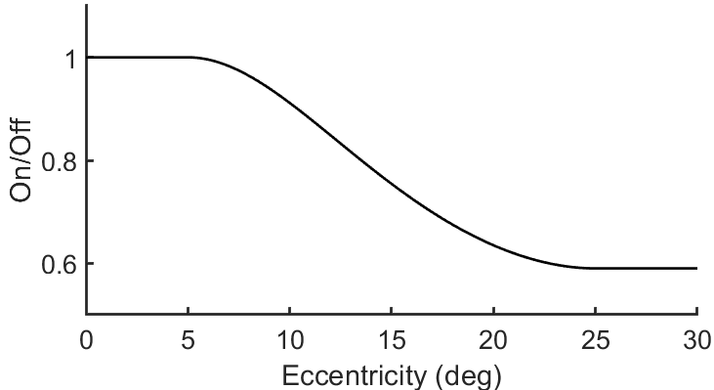
Encoding > Encoder Construction > RGC Mosaics
RGC density across the visual field
All RGCs
P Cell Ratio
M Cell Ratio
Assume all the rest
are M Cells
M Cell On/Off Ratio
Dendritic field diameter:
$$1.3±0.1$$
RF diameter ratio: $1.3$
Density ratio: $1/1.3^{2}$
P Cell On/Off Ratio
Modified from Drasdo’s
Watson, JoV, 2014; Drasdo et al, VisRes, 2007; Dacey & Peterson, PNAS, 1992

Slide 11
Encoding > Encoder Construction > RGC Mosaics
P ON
P OFF
Examples for $[−5°,5°]$
Watson, JOV, 2014; @WatsonRGCModel; Drasdo et al, VisRes, 2007; Dacey & Peterson, PNAS, 1992

Slide 12
Encoding > Encoder Construction > RGC Mosaics
M ON
M OFF
Examples for $[−5°,5°]$
Watson, JOV, 2014; @WatsonRGCModel; Drasdo et al, VisRes, 2007; Dacey & Peterson, PNAS, 1992

Slide 13
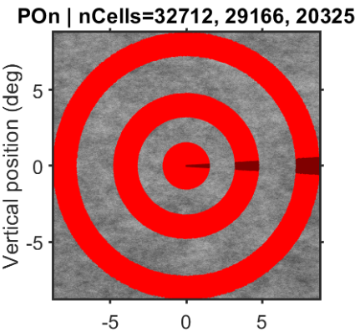
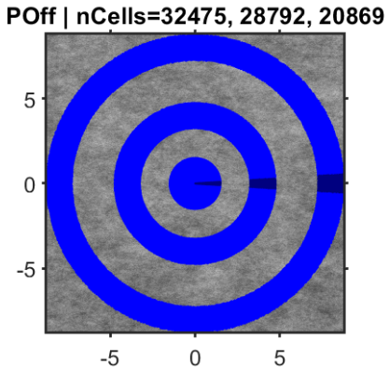
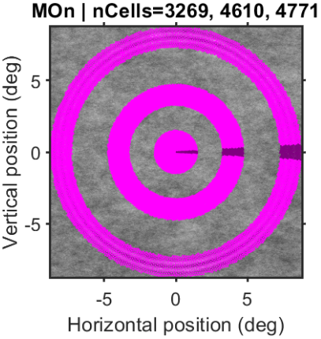
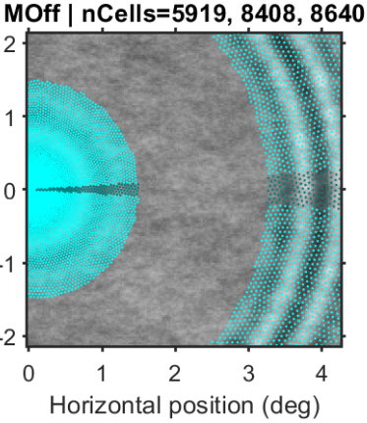
Encoding > Encoder Construction > RGC Mosaics
Light color:
Cells selected for the model
Dark color:
Cells used in the model
2% of the annulus area
Notes:
Dark color for cells used in the model, 2% of area

Slide 14
Outline
Motivation
Behavioral Study on Post Saccadic Dynamics
Goals of the Model
Network Framework
Encoding
Encoder Construction: Mosaics, RFs
Modeled Activities
Decoding
Approach
Results
Summary; Issues

Slide 15
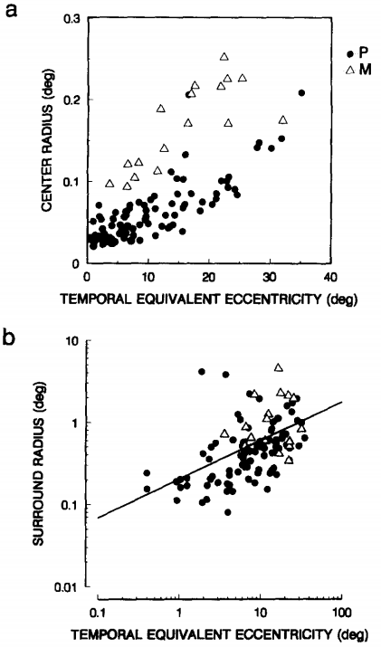
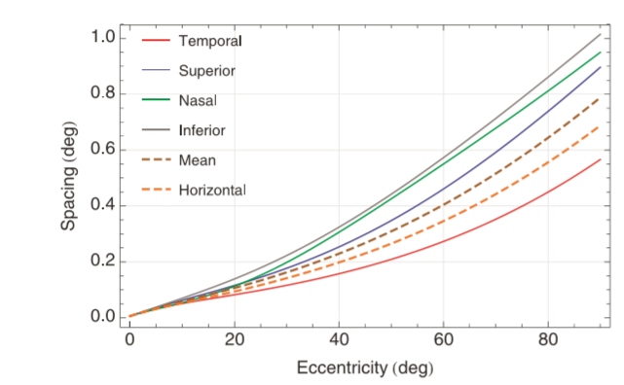
Encoding > Encoder Construction > RGC RFs
Spatial receptive field: Radius
Radius VS Ecc (Figure 4)
Spacing VS Ecc
&
Radius VS Spacing
Croner & Kaplan, VisRes, 1995; Watson, JoV, 2014

Slide 16
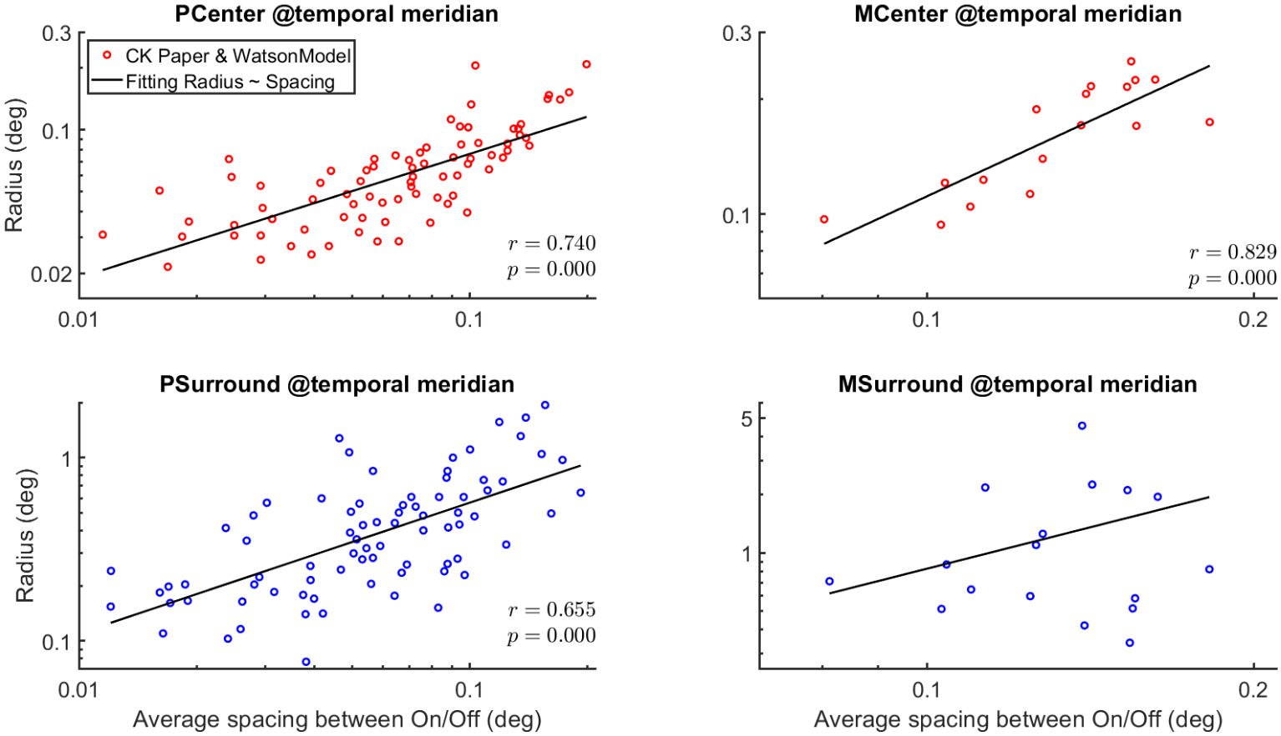
Encoding > Encoder Construction > RGC RFs
$$\log{R}\sim a\log{d}+b$$
Spatial receptive field: Radius
$$R_{MS}\left(d\right)=\frac{R_{MC}\left(d\right)R_{PS}\left(d\right)}{R_{PC}\left(d\right)}$$
Croner & Kaplan, VisRes, 1995; Watson, JoV, 2014

Slide 17
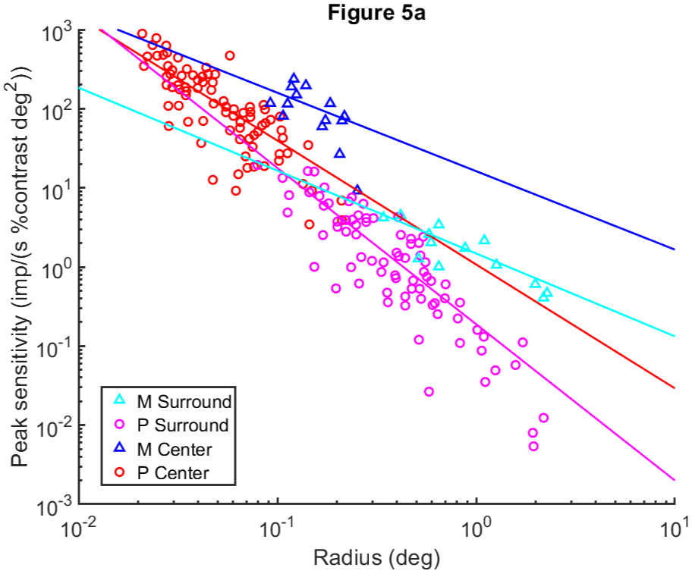
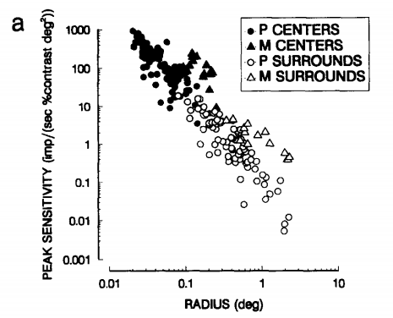
Encoding > Encoder Construction > RGC RFs
Spatial receptive field: Peak Sensitivity
Fitting of Digitized Data
Peak Sensitivity VS Radius (Figure 5)
Croner & Kaplan, VisRes, 1995

Slide 18
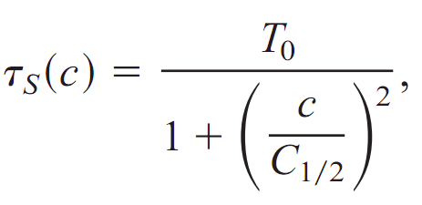
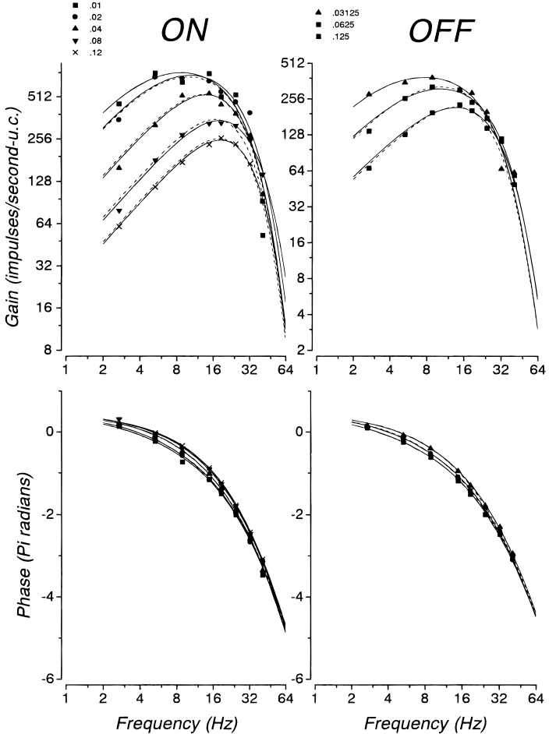
Encoding > Encoder Construction > RGC RFs
Temporal receptive field
P Cell
M Cell
Assuming insensitive to 0 Hz:
$$H_{s}=1.0$$
Benardete & Kaplan, VisNeu, 1997a
Benardete & Kaplan, VisNeu, 1999
Notes:
P Cell: Fourier transforms of the first-order impulse responses
However, $H_{0}=1$ may not be true for P cells

Slide 19
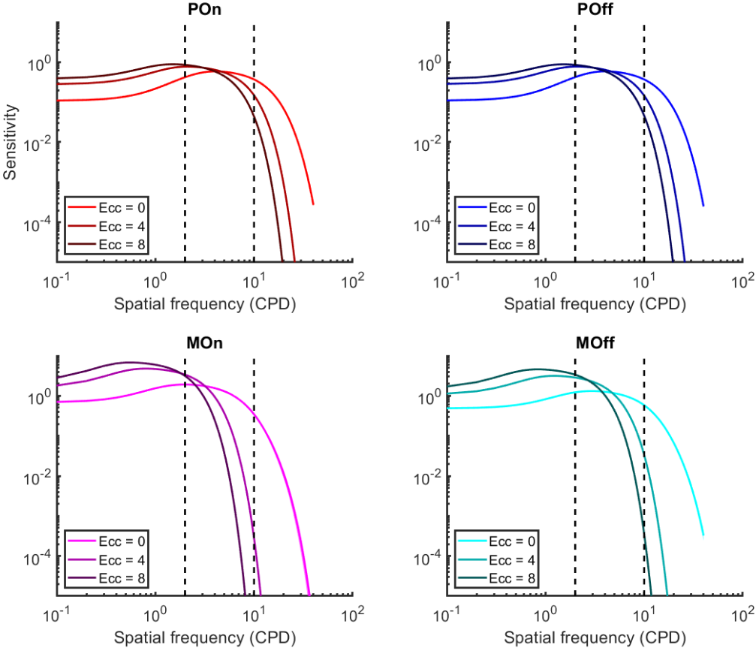
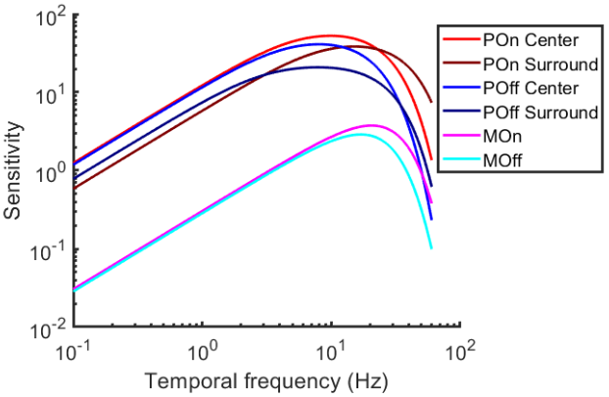
Encoding > Encoder Construction > RGC RFs
Spatio-temporal sensitivity
of cells used
Notes:
P Cell: Fourier transforms of the first-order impulse responses

Slide 20
Outline
Motivation
Behavioral Study on Post Saccadic Dynamics
Goals of the Model
Network Framework
Encoding
Encoder Construction: Mosaics, RFs
Modeled Activities
Decoding
Approach
Results
Summary; Issues

Slide 21
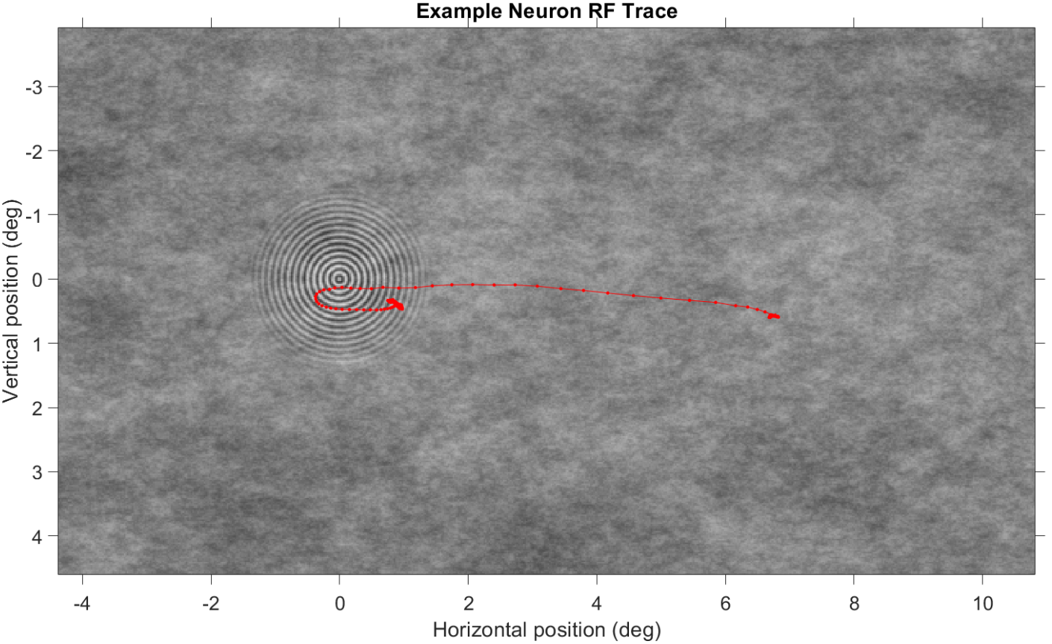
Encoding > Modeled Activities
Notes:
P Cell: Fourier transforms of the first-order impulse responses

Slide 22
Encoding > Modeled Activities > Absent

Slide 23
Encoding > Modeled Activities > SF=2, Contrast = 0.5

Slide 24
Encoding > Modeled Activities > SF=10, Contrast = 0.5

Slide 25
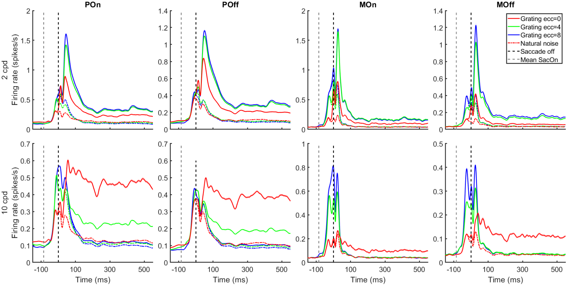
Encoding > Modeled Activities > Mean Population Activity
Contrast = 0.5
Notes:
Shade: SEM

Slide 26
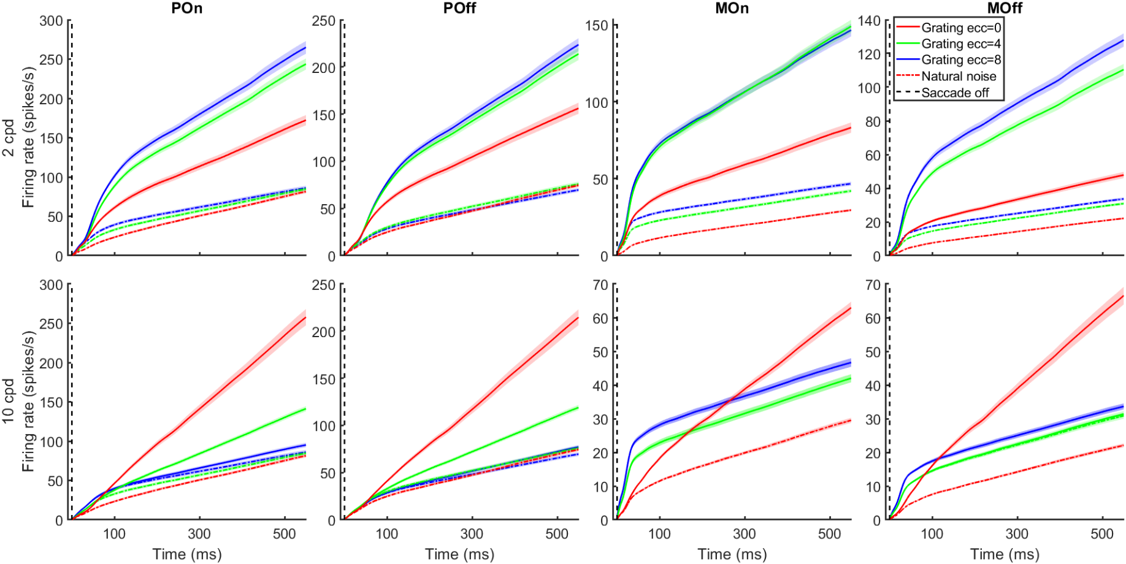
Encoding > Modeled Activities > Accumulated Population Activity
Contrast = 0.5
Notes:
Shade: SEM

Slide 27
Outline
Motivation
Behavioral Study on Post Saccadic Dynamics
Goals of the Model
Network Framework
Encoding
Encoder Construction: Mosaics, RFs
Modeled Activities
Decoding
Approach
Results
Summary; Issues

Slide 28
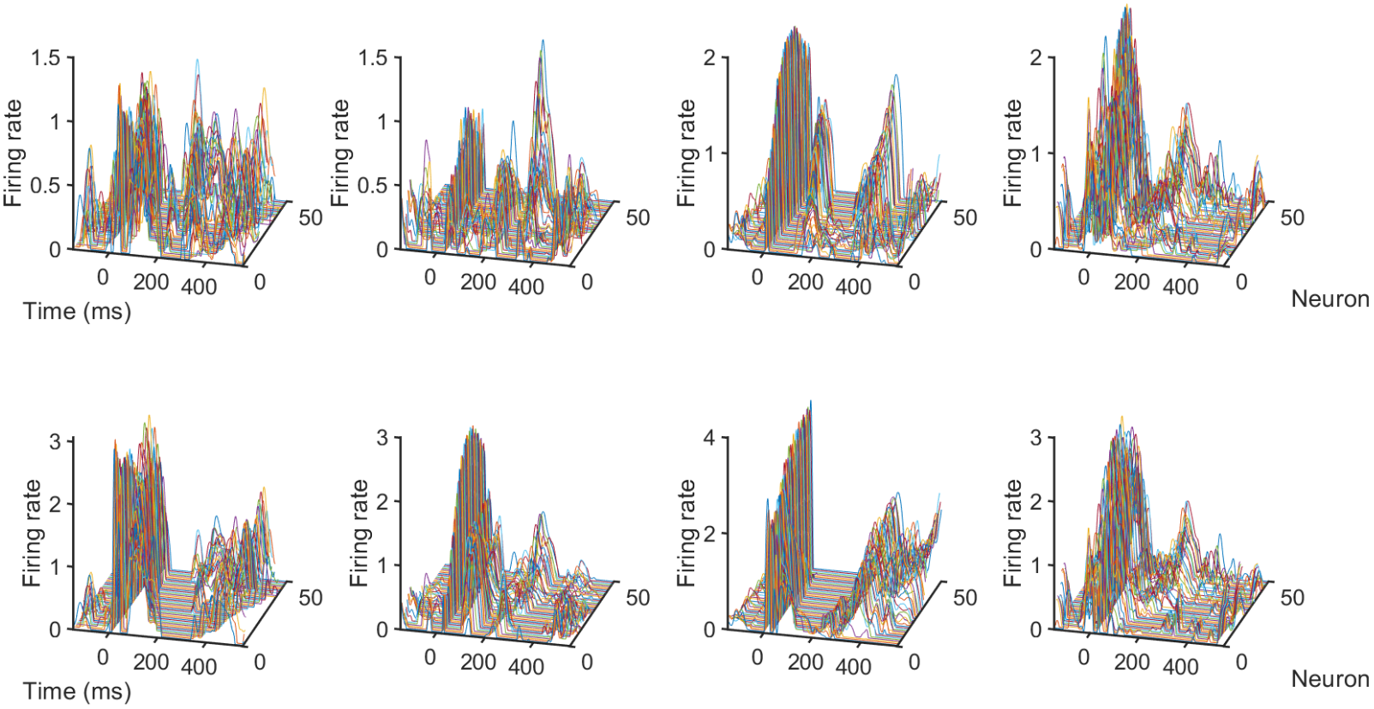
Decoding > Approach > Spatio-temporal Activity Map
Trial 1
Trial 2
Trial 3
Trial 4
Absent
2 cpd
Notes:
P On cells

Slide 29
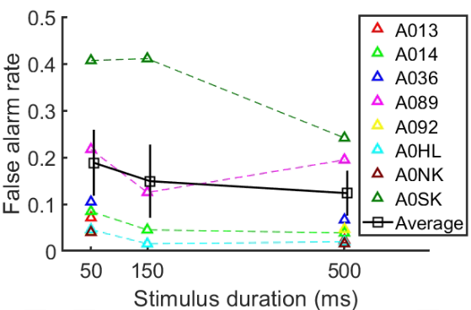
Decoding > Approach > Uniform Weights
Model with uniform weights
Uniform spatial & temporal weights
Set a threshold for decision
Threshold <= empirical false alarm rate
Linear interpolation for non-tested duration
Spatial weights
Temporal weights

Slide 30
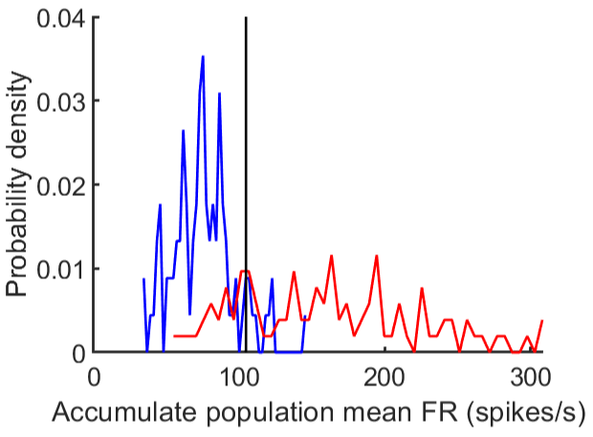
Decoding > Approach > Uniform Weights
Trial 1
Absent
Threshold
Accumulated Population FR
False
alarm
Hit
Accumulated Population FR
2 cpd
Notes:
Average across neurons/space
Accumulate across time

Slide 31
Decoding > Approach > Compensate Variance and Duration
Variance
For each condition, variance scaler = $N_{total}/N_{used}≈$50
Duration
Considering the delay of neural activity, for a given stimulus duration, the time window for neural decoding is extended by 50 ms
An extra 7 ms is added considering the difference between online saccade off and offline saccade off
Total Cells | P On | P Off | M On | M Off
Ecc $0°$ | 32712 | 32475 | 3269 | 5919
Ecc $4°$ | 29166 | 28792 | 4610 | 8408
Ecc $8°$ | 20325 | 20869 | 4771 | 8640
Used Cells | P On | P Off | M On | M Off
Ecc $0°$ | 670 | 667 | 67 | 117
Ecc $4°$ | 624 | 603 | 96 | 179
Ecc $8°$ | 484 | 499 | 112 | 202

Slide 32
Outline
Motivation
Behavioral Study on Post Saccadic Dynamics
Goals of the Model
Network Framework
Encoding
Encoder Construction: Mosaics, RFs
Modeled Activities
Decoding
Approach
Results
Summary; Issues

Slide 33
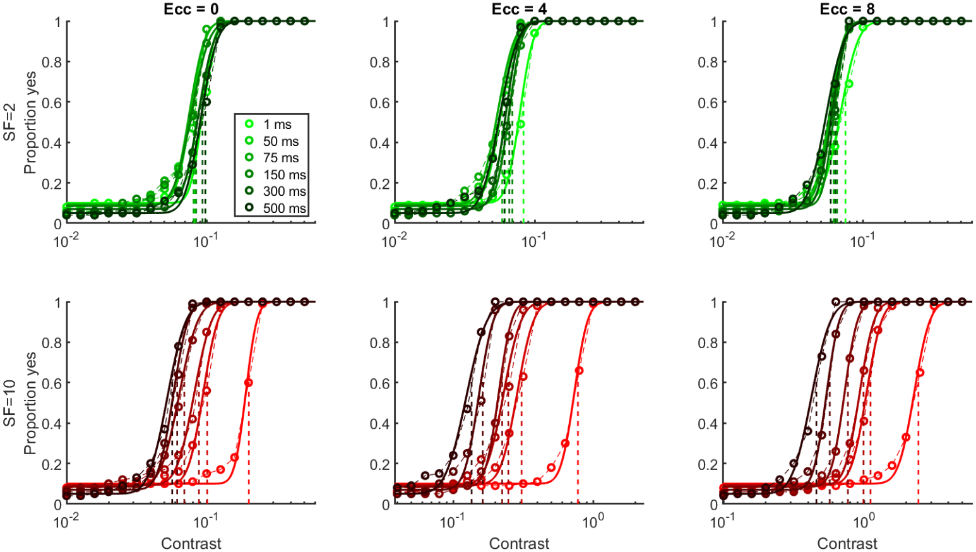
Decoding > Results > Psychometric Curves by Layers Average

Slide 34
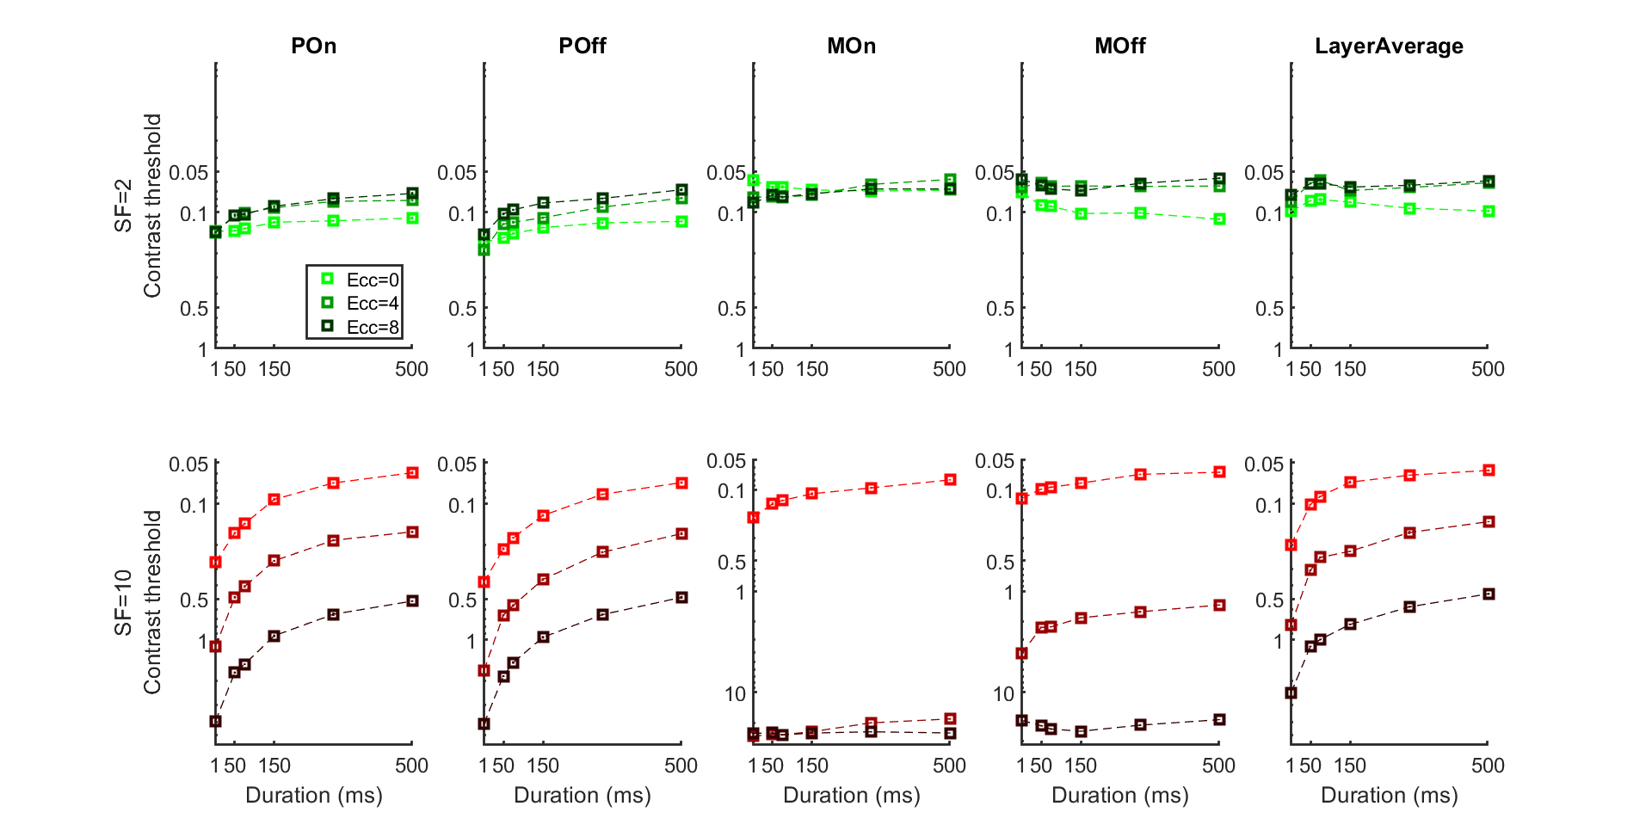
Decoding > Results > Contrast Threshold
Notes:
targetRatio = $(1−chance)(1−e^{−1}) + chance$;

Slide 35
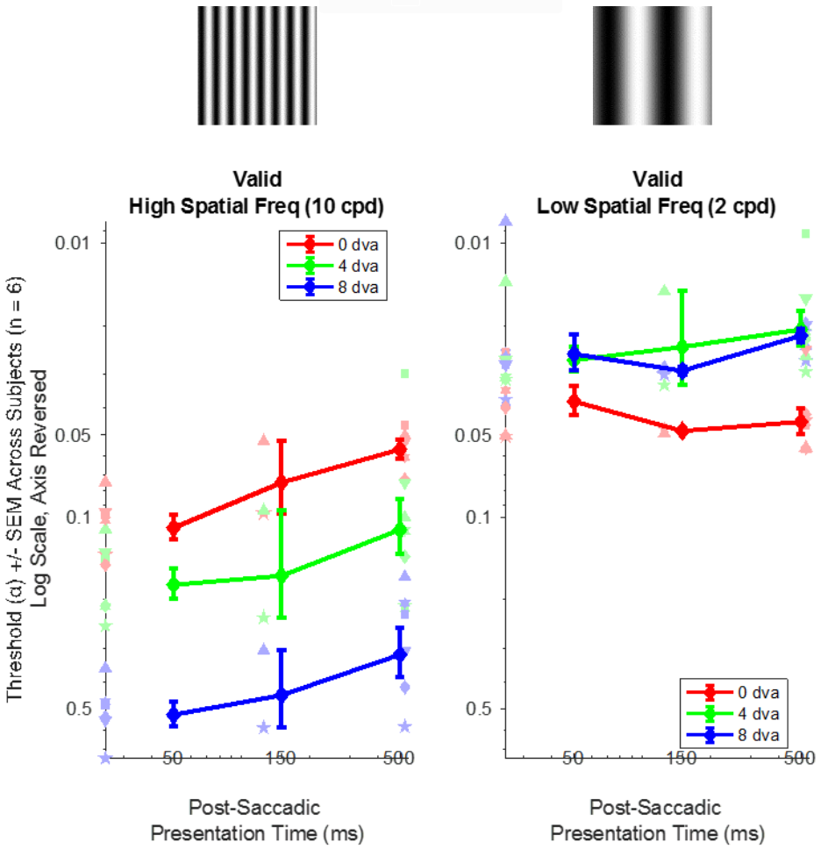
Decoding > Results > Contrast Threshold
Human
Model

Slide 36
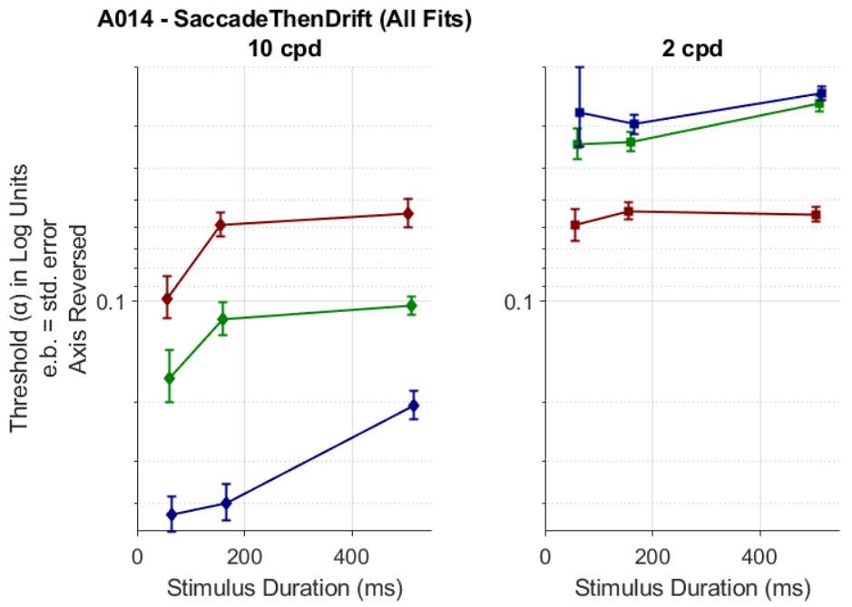
Decoding > Results > Contrast Threshold
Human
Model

Slide 37
Decoding > Results > Contrast Threshold
Human
Model

Slide 38
Outline
Motivation
Behavioral Study on Post Saccadic Dynamics
Goals of the Model
Network Framework
Encoding
Encoder Construction: Mosaics, RFs
Modeled Activities
Decoding
Approach
Results
Summary; Issues

Slide 39
Summary
Replicate Empirical Results
Contrast sensitivity increases as duration prolongs for 10 cpd
The increment mostly happens within 150 ms
No significant increase in contrast sensitivity for 2 cpd
Contrast sensitivity is higher for 2 cpd
Foveal sensitivity is higher than eccentric for 10 cpd, but the opposite for 2 cpd
Replicate on all subjects
Prediction
Predict that the dynamics of 10 cpd is caused by ocular drifts

Slide 40
Issues
For temporal receptive field, all cells are assumed to have $H_{s}=1$
Based on the assumption that RGCs are insensitive at all to 0 Hz
However, Benardete & Kaplan 1997 and Benardete & Kaplan 1999 reported that P cells have $H_{0}$ always/substantially smaller than 1
How to validate this? Or, do we need this assumption at all?
Let the model predicts the false alarm rate?

Slide 41
Thanks for
Your Attention!
AD: in-lab subjects needed

Slide 42
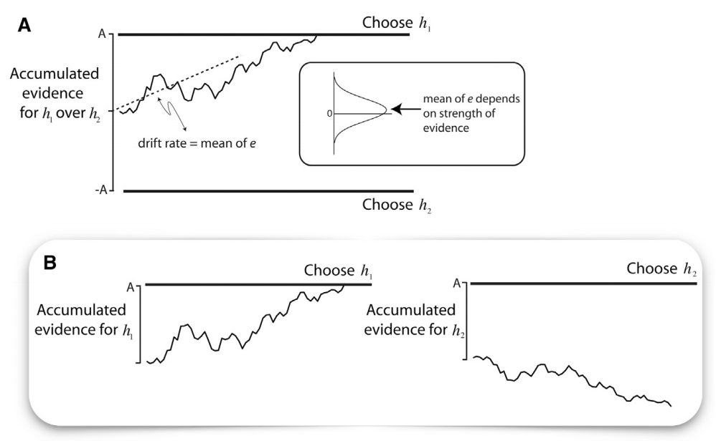
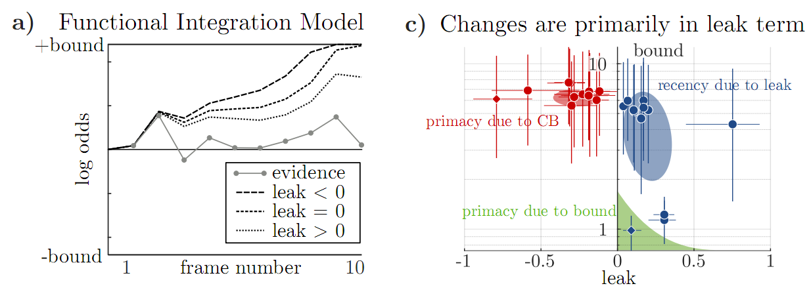
Decoding: Plan: Decision Making
Classical decision model
Decision made at the time point reaching the threshold
Result in primacy effect
My implementation
Decision made at the end of integration time window
Alternatives:
At the time point reaching the threshold
At the time point reaching the threshold after stimulus offset
with an upper limit of the window length?
Shadlen, Shohamy, Neuron, 2016
Lange, et al., eLife, under preparation

Slide 43
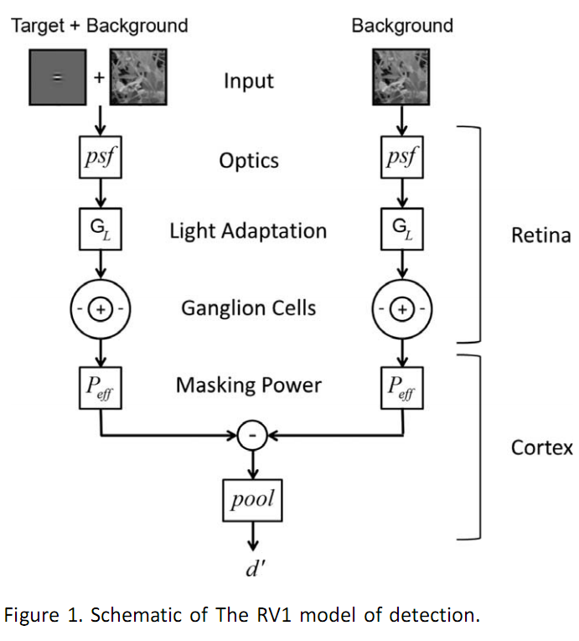
Decoding: Plan: RV1 Model
Implement cortical mechanisms to:
Limit the spatial frequency and orientation content in the RGC responses
Pool the neural responses to make perceptual decisions
P cells used because:
Evidence shows that they are responsible for detection performance under conditions of low to moderate temporal frequency
This assumption does not hold in our case
(P Cells)
看不到希望
Bradley et al, JoV, 2014

Slide 44
Decoding: Approach
Average Thresholding
Uniform spatial & temporal weights
Set a threshold for decision
Threshold <= given false alarm rate (~10%)
Spatial weights following structure of annulus
Weights following cosine function
$$w_{i}^{ON}=0.5cos\left(2πf(E_{i}−R)\right)+0.5$$
$$w_{i}^{OFF}=−0.5cos\left(2πf(E_{i}−R)\right)+0.5$$
where $E_{i}$ is eccentricity of neuron $i$, $f$ and $R$ are the spatial frequency and radius of the annulus respectively
Considering another set of weights with opposite phase?
Temporal weights determined by $d′$ between two probability distributions of population activity
Spatial weights
Temporal weights

Slide 45
Outline
Network Framework
Example Neurons
Locations, Traces, Numbers, Sensitivity
Videos
Mean Firing Rate Profile
Decoding
Approach
Average Thresholding
Cosine Spatial Weights
Temporal Weight by by 𝑑′
Plan

Slide 46
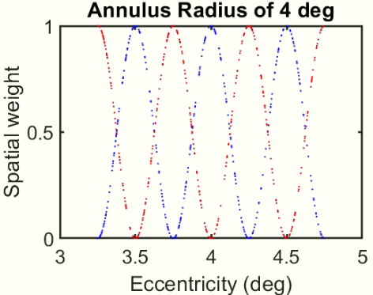
Decoding: Approach: Cosine Spatial Weights
Weights following cosine function
$$w_{i}^{ON}=0.5cos\left(2πf(E_{i}−R)\right)+0.5$$
$$w_{i}^{OFF}=−0.5cos\left(2πf(E_{i}−R)\right)+0.5$$
where $E_{i}$ is eccentricity of neuron $i$, $f$ and $R$ are the spatial frequency and radius of the annulus respectively

Slide 47
Decoding: Approach: Cosine Spatial Weights
POn & POff
MOn & MOff
P & M

Slide 48
Decoding: Approach: Cosine Spatial Weights
P & M
Human
Model

Slide 49
Decoding: Approach: Cosine Spatial Weights

Slide 50
Outline
Network Framework
Example Neurons
Locations, Traces, Numbers, Sensitivity
Videos
Mean Firing Rate Profile
Decoding
Approach
Average Thresholding
Cosine Spatial Weights
Temporal Weight by $d′$
Plan

Slide 51
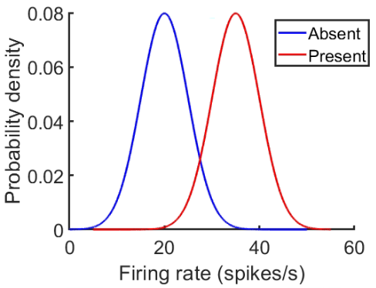
Decoding: Approach: Temporal Weight by 𝑑′
For population at time $t$
$$w^{t}$$
$w^{t}=\frac{\overline{X_{present}}−\overline{X_{absent}}}{ \sqrt{D{\left(X_{present}\right)}^{2}+D{\left(X_{absent}\right)}^{2}}}$
Population mean firing rate

Slide 52
Decoding: Approach: Temporal Weight by 𝑑′

Slide 53
Decoding: Approach: Temporal Weight by 𝑑′
Human
Model

Slide 54
Decoding: Approach: Temporal Weight by 𝑑′

