Slide 1
Modeling Ocular Drift
Janis Intoy
APLab Meeting – January 21, 2020

Slide 2
Overview
Is Brownian Motion a good model of drift?
Task-dependent control of drift

Slide 3
Brownian Motion model of ocular drift
Brownian motion model of drift has helped us understand the visual functions of drift and explain empirical results

Slide 4
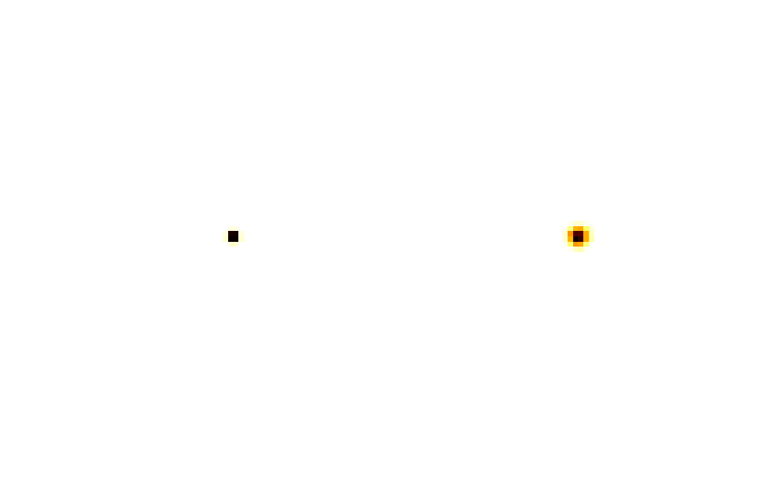
Brownian Motion: known properties
Parameterized by the diffusion constant, D
Gaze displacement at any given time follows the normal distribution
  Variance increases linearly with time
  <r²> = 4Dt
Probability of gaze displacement over time
smaller
larger
Diffusion Constant

Slide 5
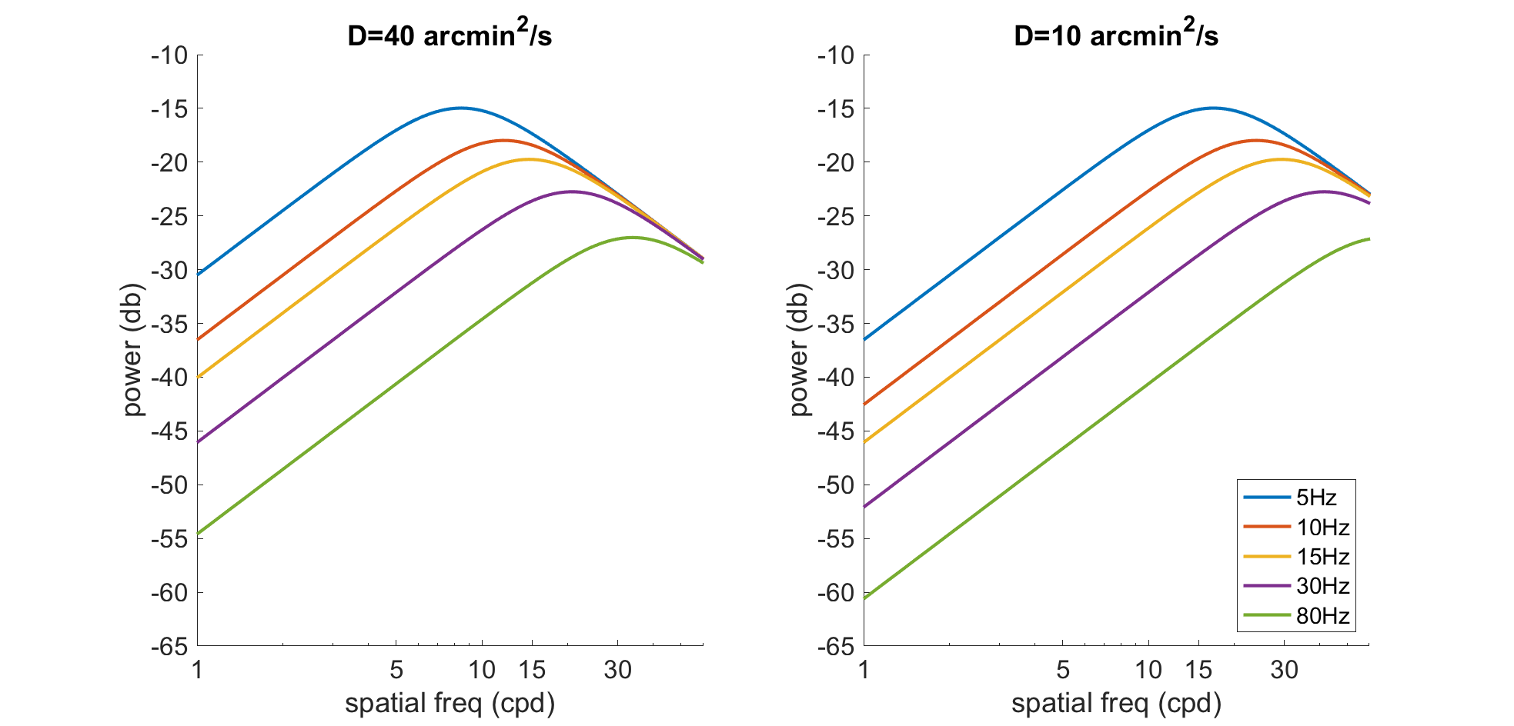
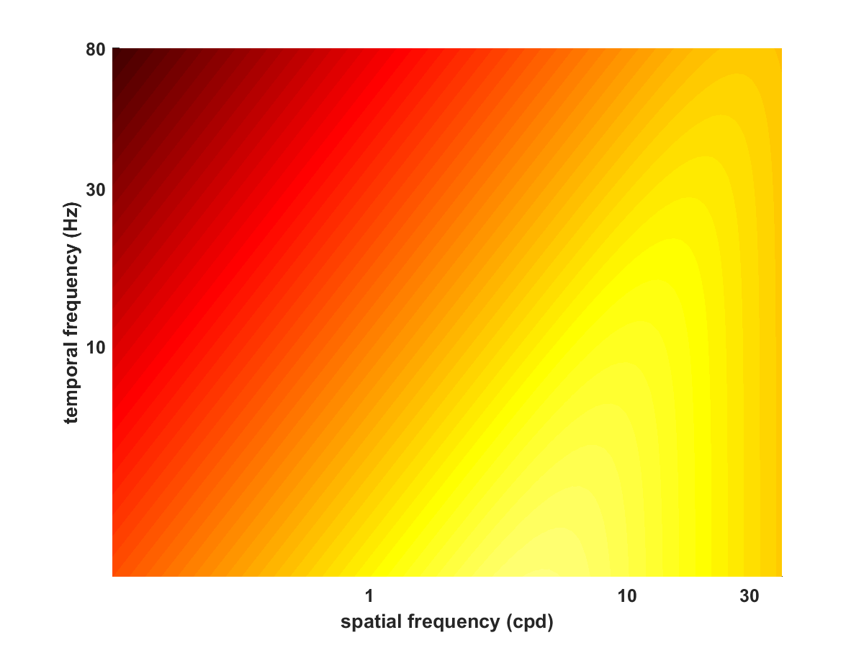
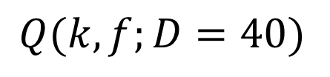
Brownian Motion: known properties
Power provided by drift
$Q(k, f;D=40)$
Power (db)

Slide 6
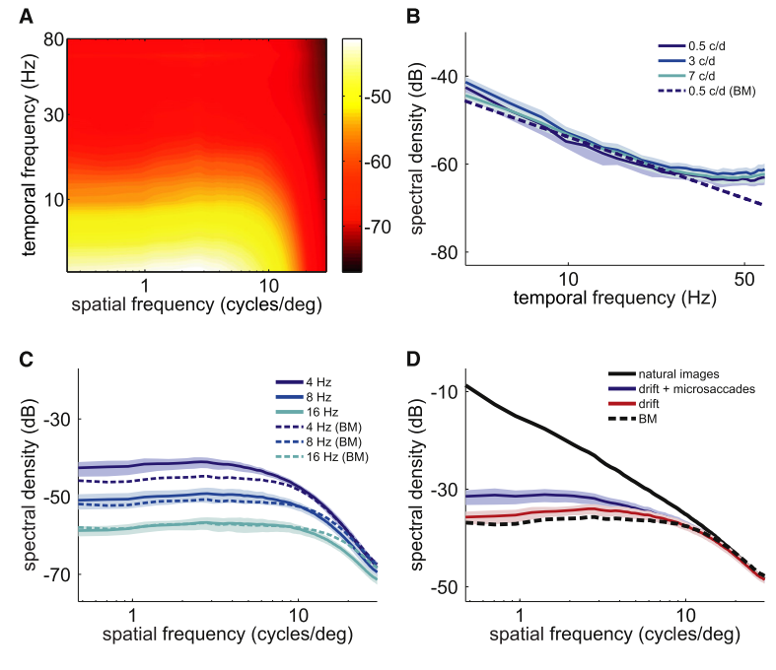
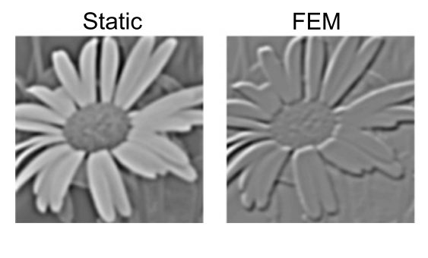
1. Spatial Whitening
Content of Visual Input
Kuang et al (2012)

Slide 7
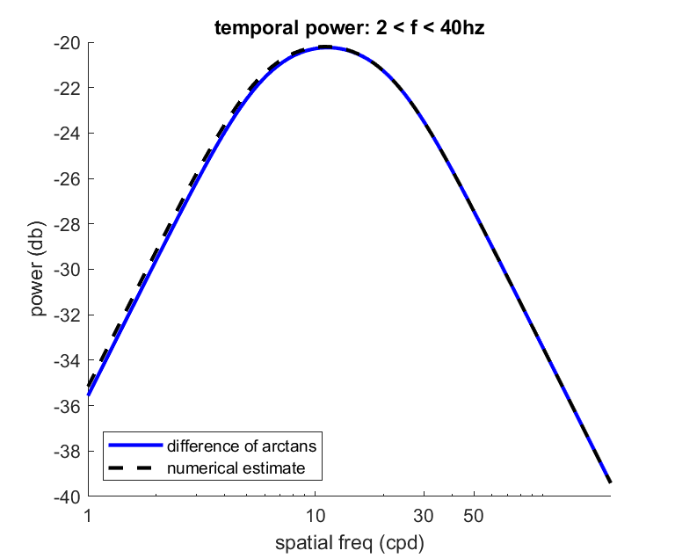
2. Selective enhancement of high spatial frequencies
Power provided by drift

Slide 8
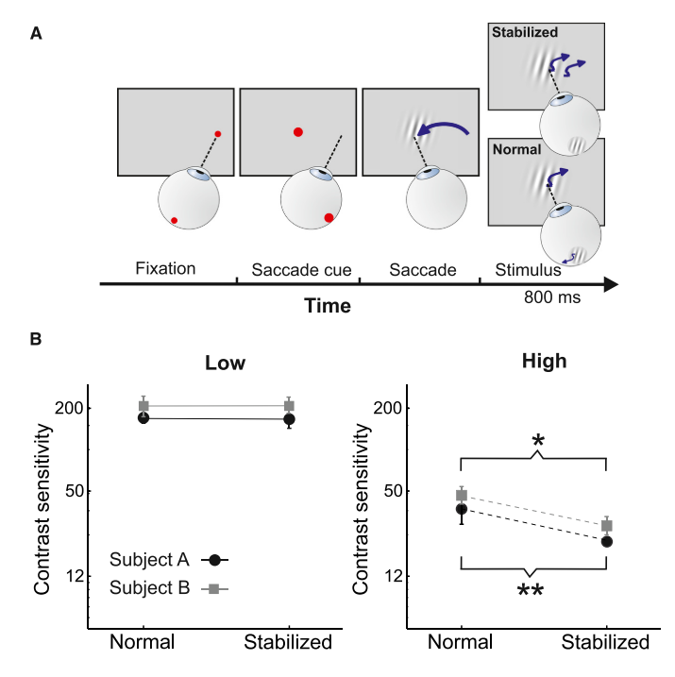
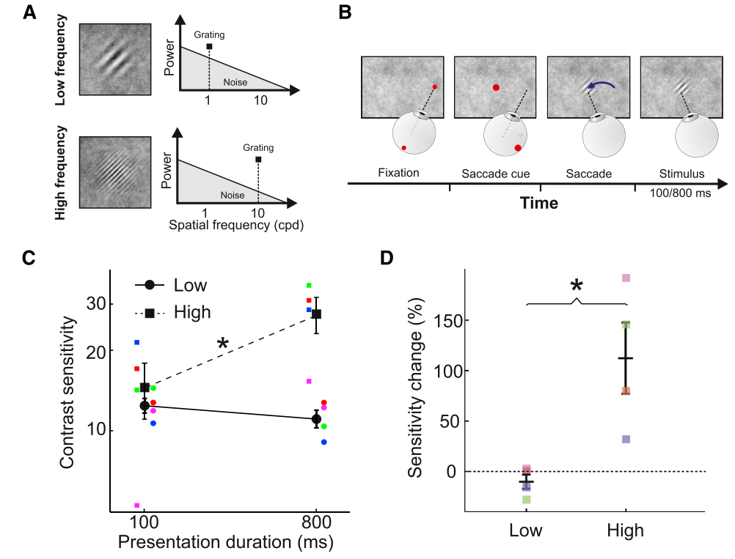
2. Selective enhancement of high spatial frequencies
Boi et al (2017)

Slide 9
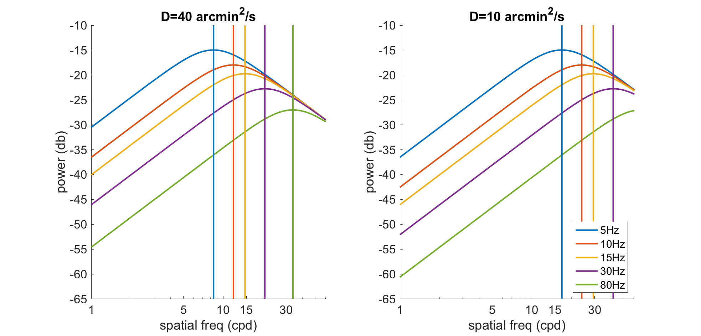
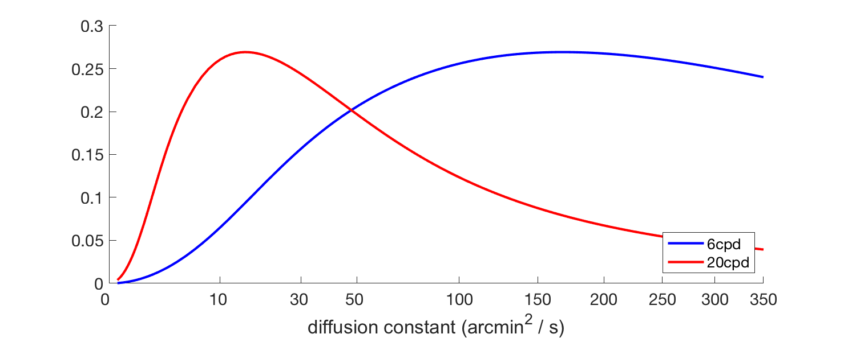
3. Optimal Drifts
Smaller D --> increases critical frequency
Temporal power

Slide 10
3. Optimal Drifts
Intoy & Rucci (in press?)

Slide 11
4. Sensitivity with altered retinal image motion
Temporal power

Slide 12
4. Sensitivity with altered retinal image motion

Slide 13
Brownian Motion model of ocular drift
Brownian Motion model of drift has helped us understand the visual functions of drift and explain empirical results
Spatial whitening (removing redundancy from visual input)
Selective enhancement of high spatial frequency in images
”optimal” drift depends on task
Sensitivity in the presence of altered retinal image motion

Slide 14
Is Brownian motion a good model of drift?

Slide 15
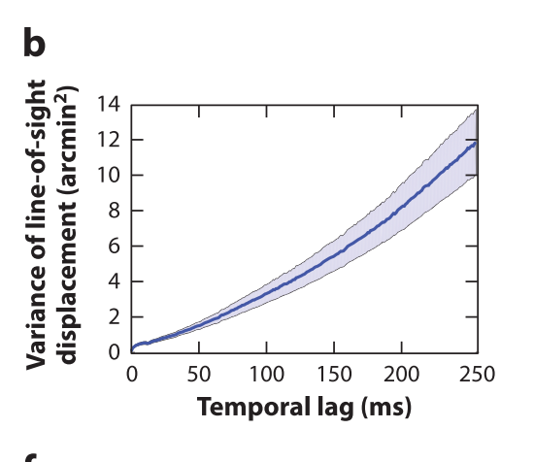
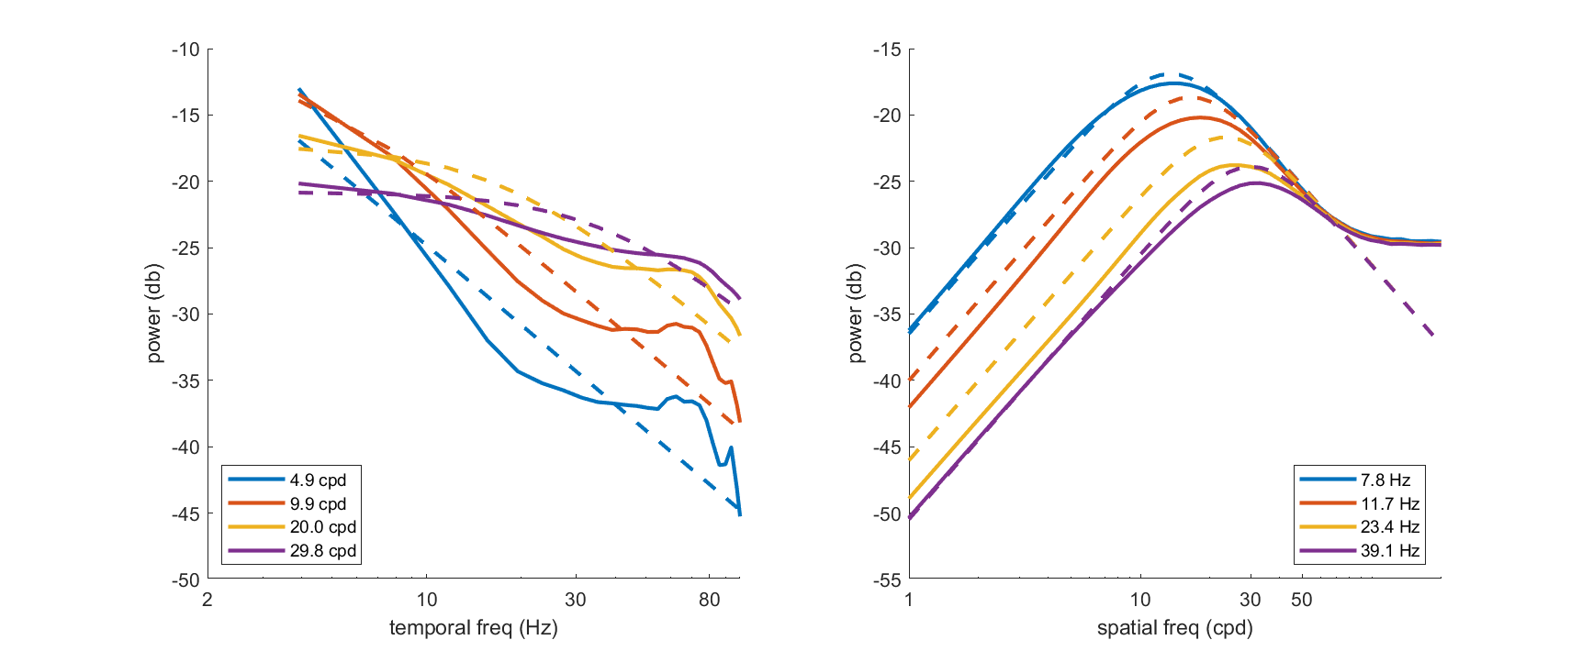
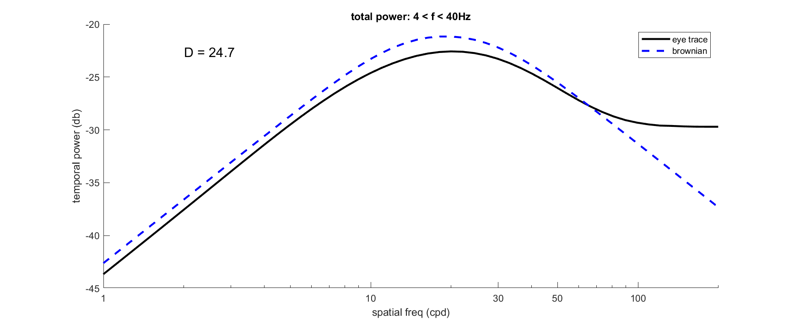
Is Brownian motion a good model of drift?
Solid lines (Qrad approach)
Dashed lines (Brownian motion)

Slide 16
Is Brownian motion a good model of drift?
Brownian Motion(BM):
  <r²> = 4Dt
Fractional Brownian Motion (fBM):
  <r²> = 4Dt^{H}
  H = 1 → Brownian Motion
Ornstein-Uhlenbeck Process (OUP):
  <r²> = 2D(1 – exp(2 θ t)) / θ
  Small θ → Brownian motion
Notes:
--- mention that fbm and OUP are generalizations of

Slide 17
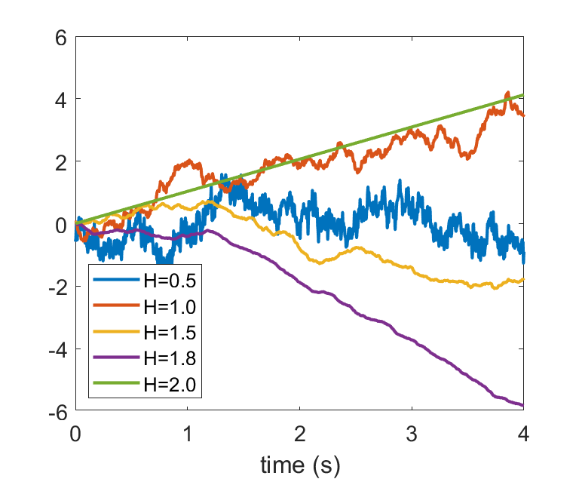
Fractional Brownian Motion: examples
Notes:
H is a roughness parameter

Slide 18
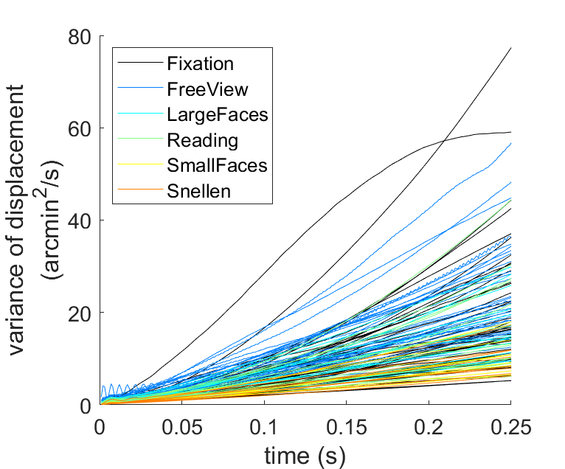
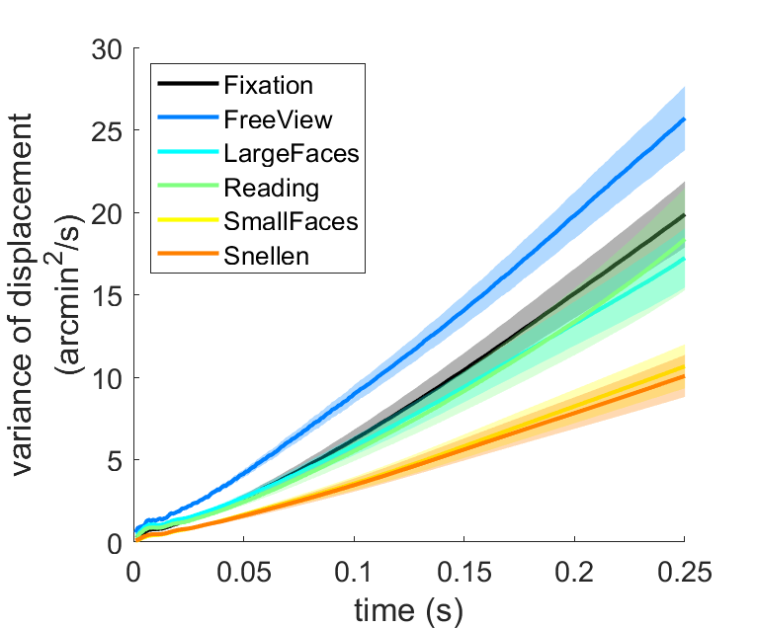
Fitting the variance of displacement

Slide 19
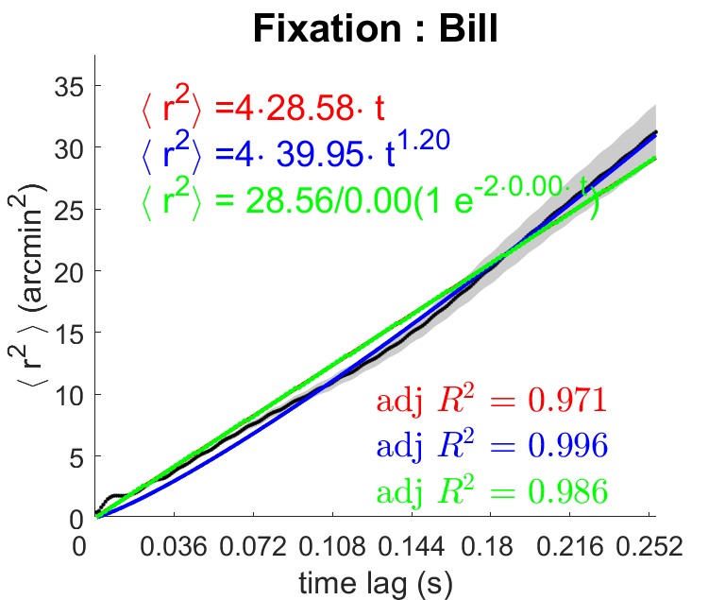
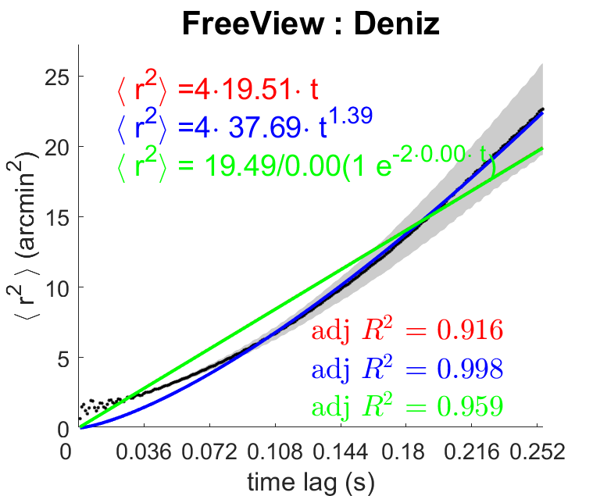
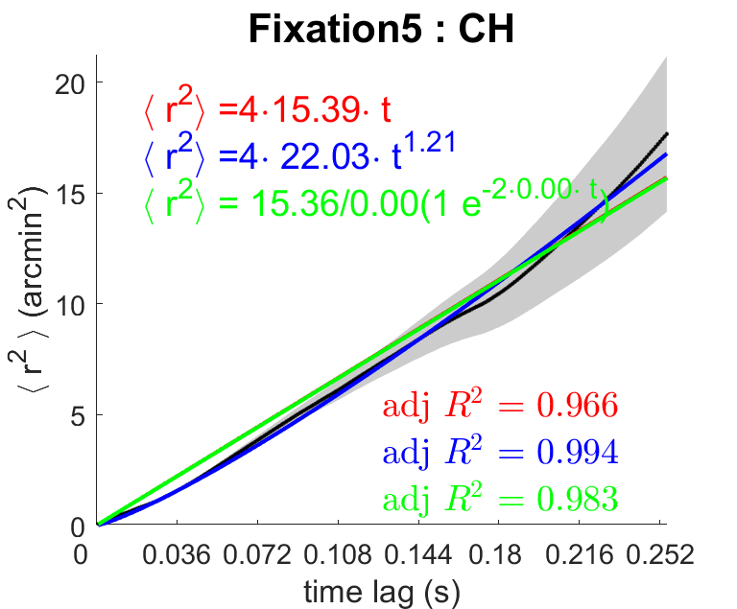
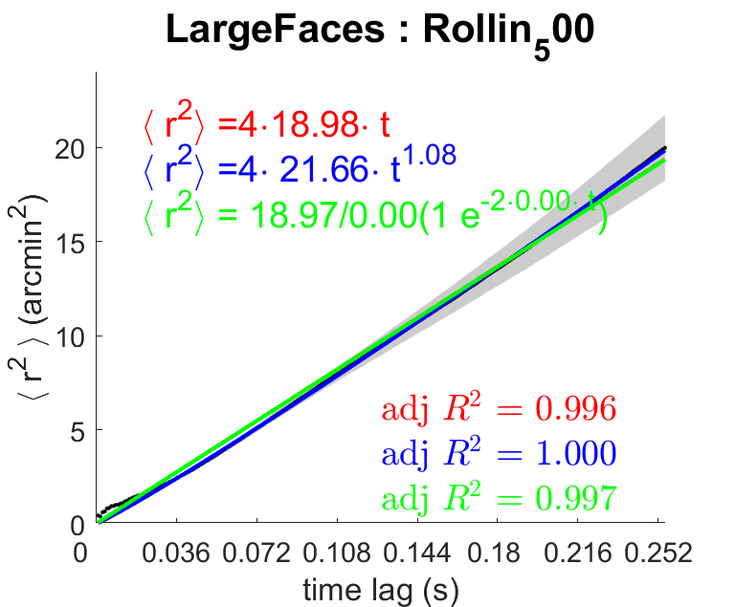
Fitting the variance of displacement
Brownian Motion(BM):
  <r²> = 4Dt
Fractional Brownian Motion (fBM):
  <r²> = 4Dt^{H}
Ornstein-Uhlenbeck Process (OUP):
  <r²> = 2D(1 – exp(2 θ t)) / θ

Slide 20
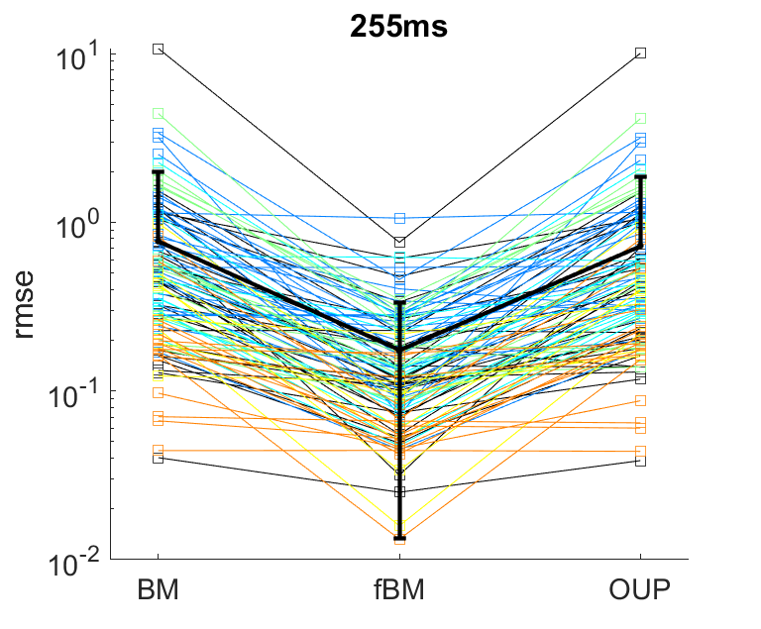
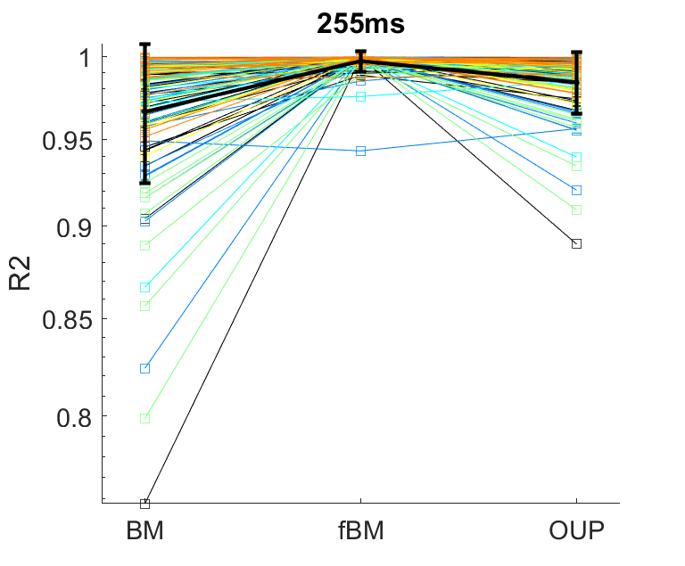
Fitting the variance of displacement

Slide 21
Is Brownian motion a good model of drift?
Brownian motion is overall a good model of drift.
Fractional Brownian motion provides a better fit for some individuals and some tasks.

Slide 22
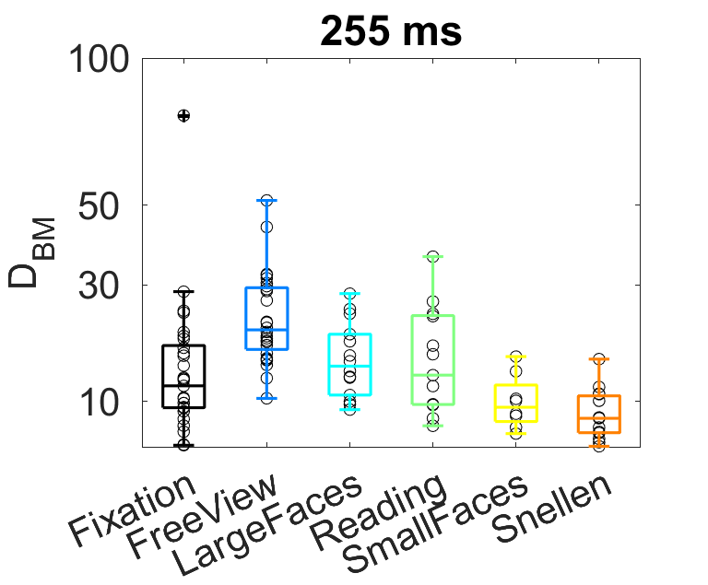
Task-dependent control of drift
Controlling eye drift alters the spatiotemporal content of the retinal input
For example, decreasing the diffusion constant increases power at high spatial frequencies.
Task-dependent control? Effect of longer or shorter fixation durations?
Brownian Motion model

Slide 23
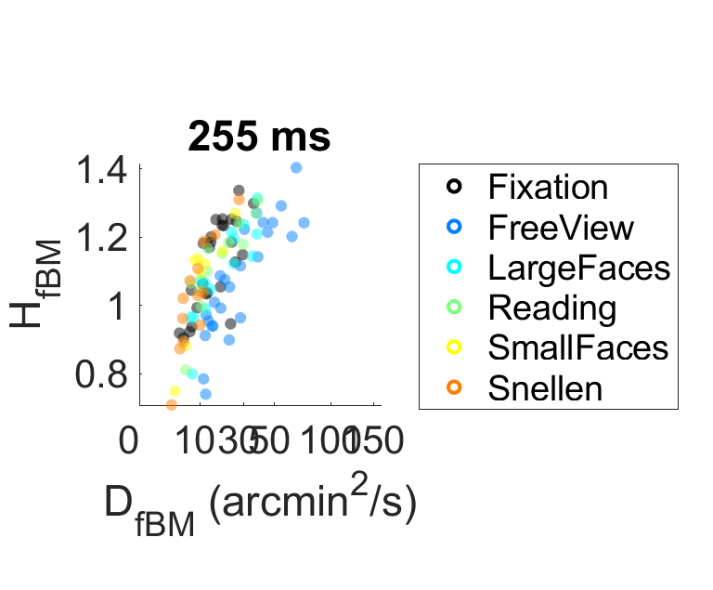
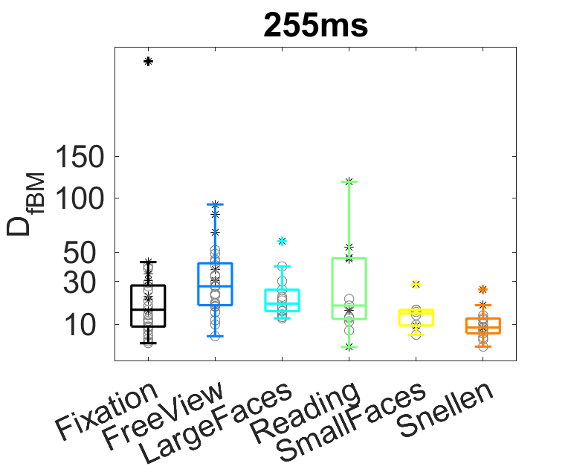
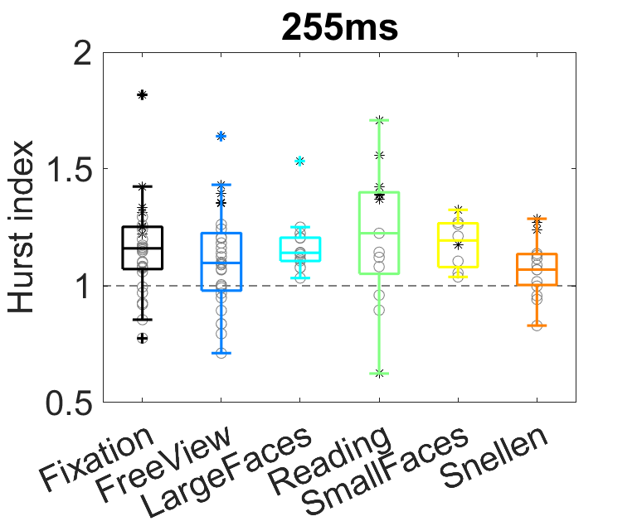
Task-dependent control of drift
Fractional Brownian Motion model
Notes:
No significant differences here in parameters – though there is an overall effect of task on both parameters
Intuition: you can use the same D but different H to cover different areas

Slide 24
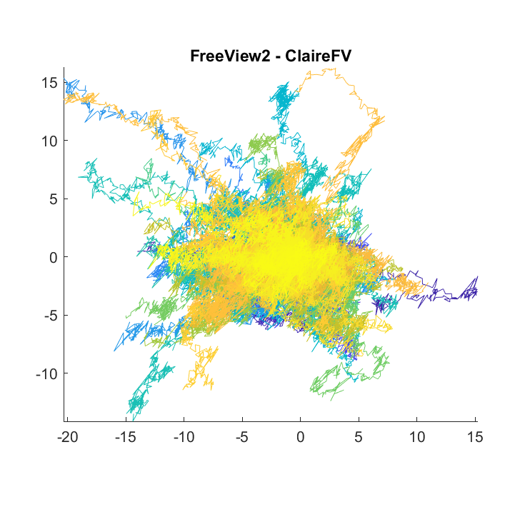
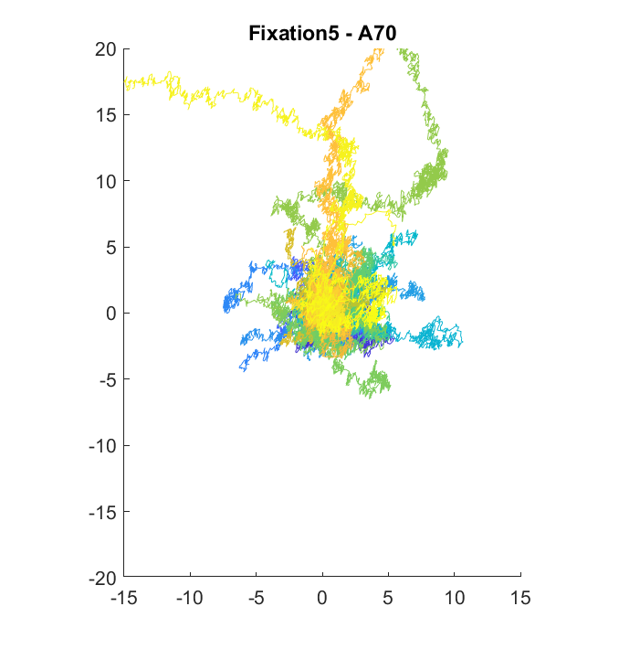
fBM: same D, different H
H = 1.75
H = 1.2

Slide 25
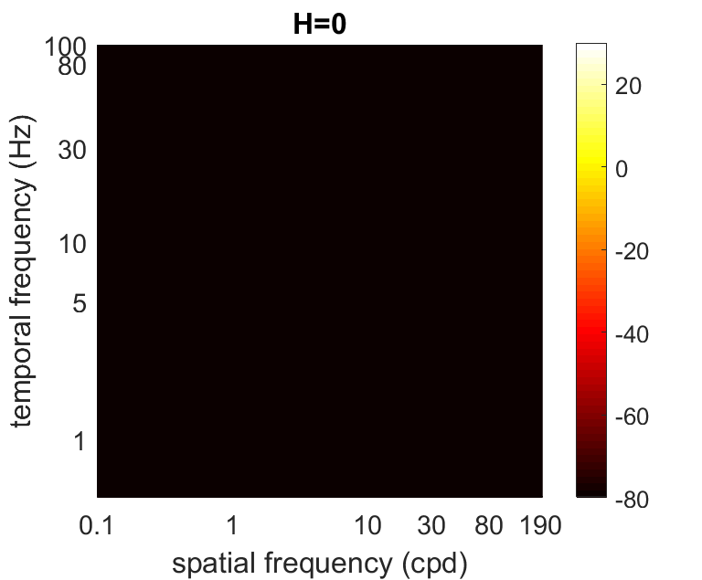
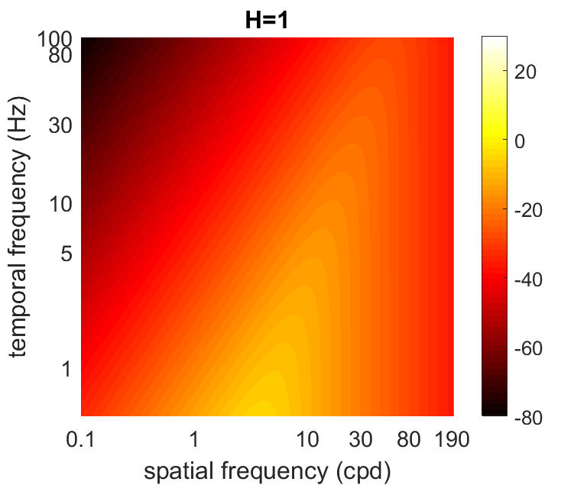
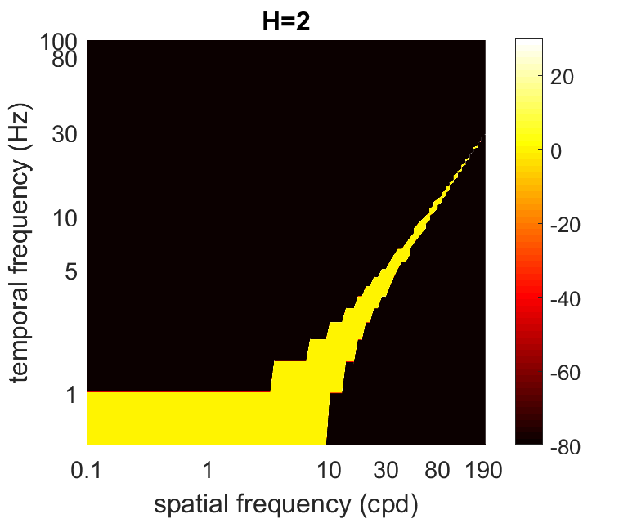
Power spectra of fBM
Closed-form PSD for only 3 cases of fractional Brownian Motion
Q(k, f; D = 20, H)

Slide 26
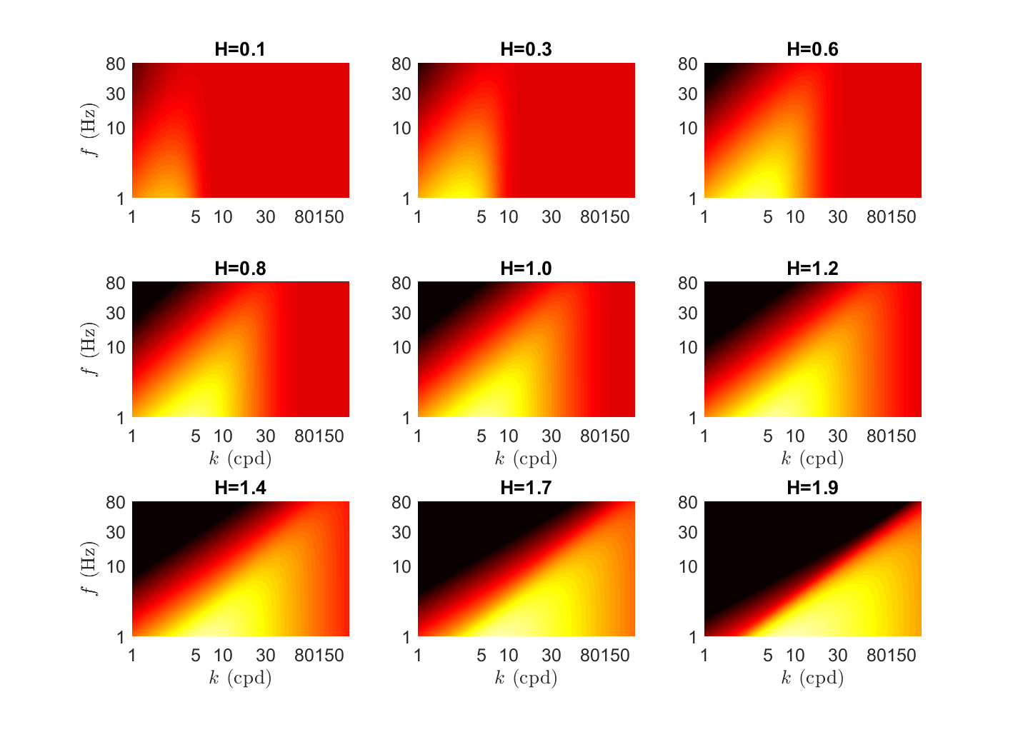
Power spectra of fBM
Numerical PSD
(see report for details)
Q(k, f; D=20, H)

Slide 27
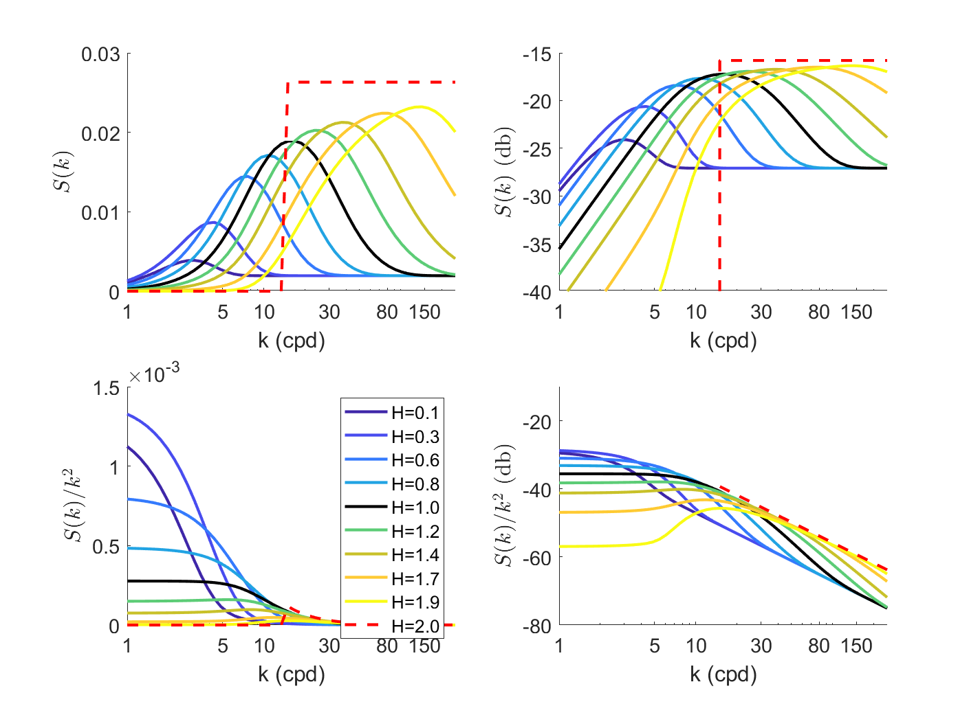
Power spectra of fBM
Numerical PSD
(see report for details)
Integrate Q(k, f; D=20, H) over 2<f<40 Hz
Larger H: higher critical frequency, but filters out low spatial frequencies

Slide 28
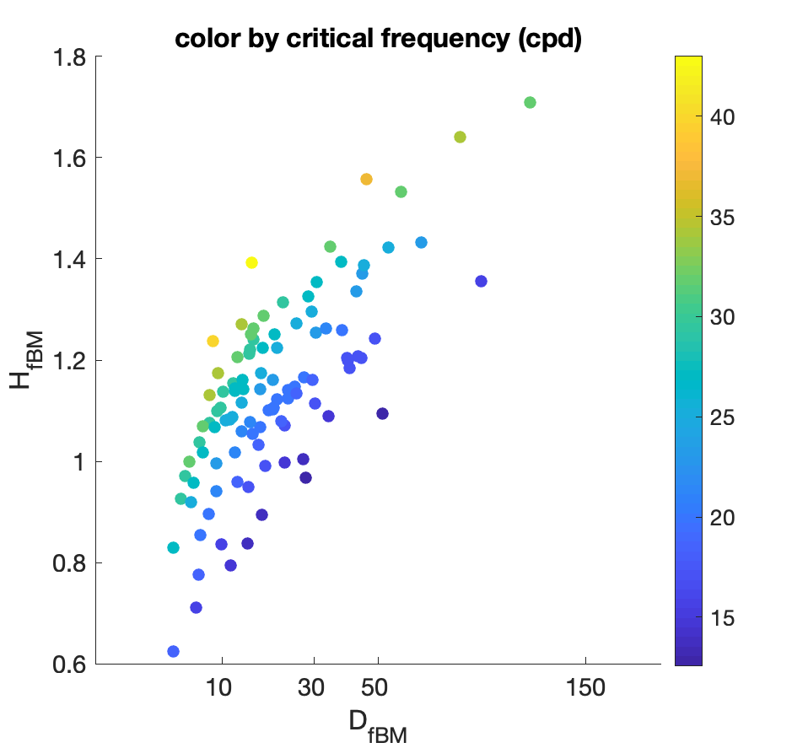
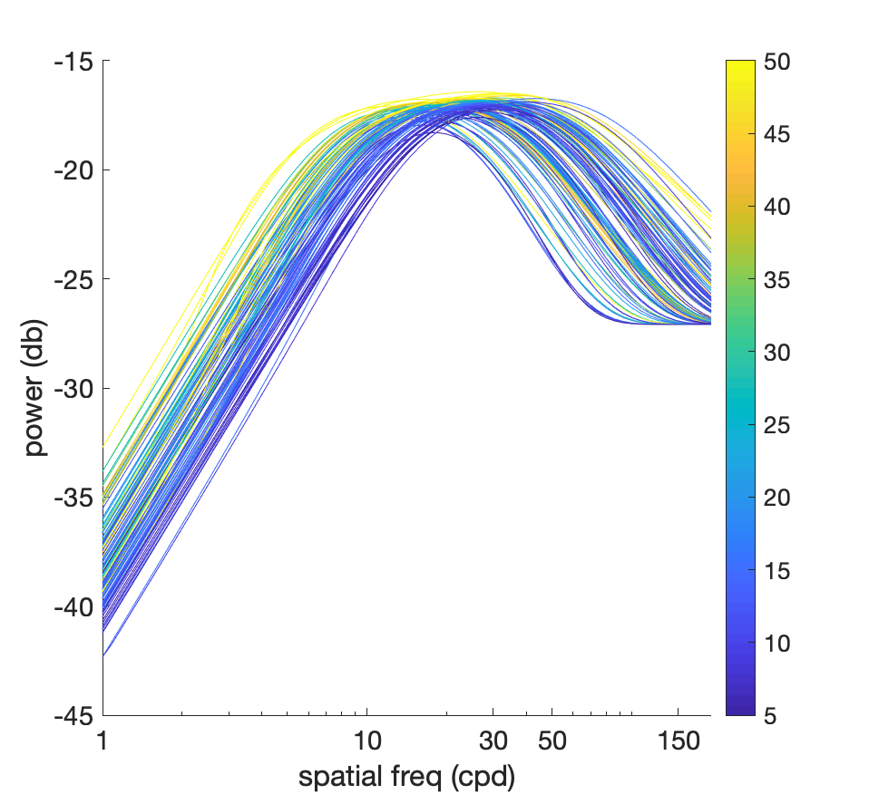
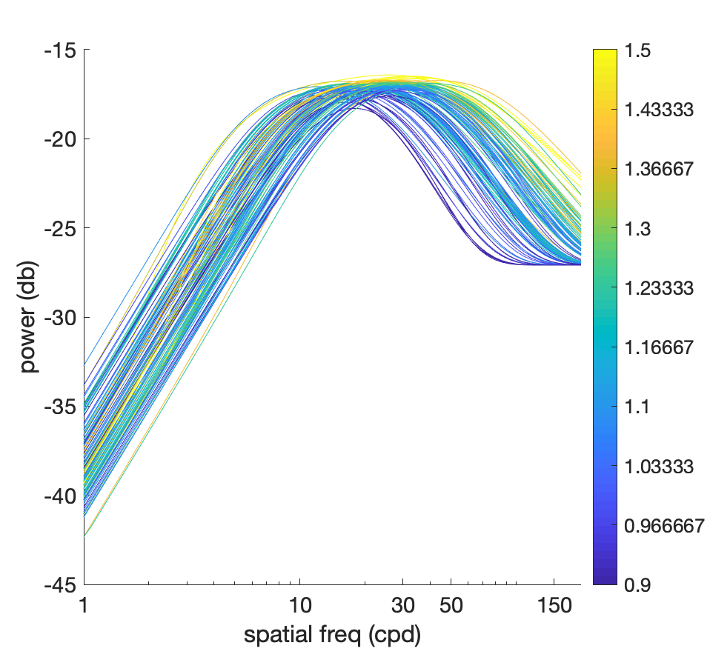
Power spectra of fBM
Numerical PSD
(see report for details)
Integrate Q(k, f; D=20, H) over 2<f<40 Hz
Larger H: higher critical frequency, but filters out low spatial frequencies
Color by diffusion constant
Color by H
Notes:
The relationship between D and H in the empirical data do not completely cancel each other out

Slide 29
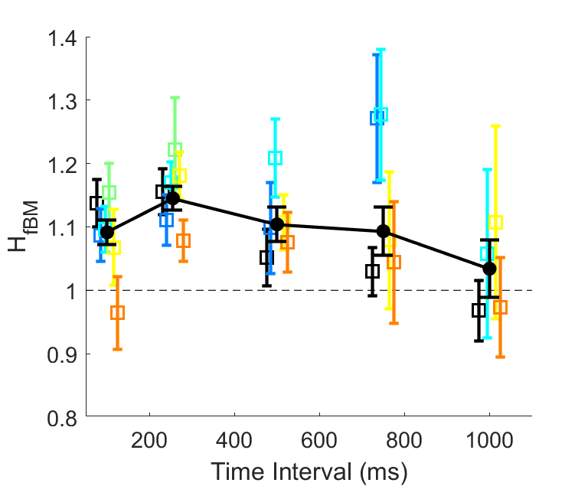
Task-dependent control of drift

Slide 30
Task-dependent control of drift
Do humans alter drift by task?
  Is this done to optimize spatial information in the visual input?
  Are there ways to improve vision based on these models?
Can humans control D and H?
  Varying both together alters the spatial frequency content of visual input, but H varies how space is explored
  Does it just depend on the inertia of the eye following saccades (which are much less frequent in high acuity tasks)

